Slide 1
National Association of Letter Carriers Retirement for City Letter Carriers
3.21.2023
Notes:
[ALWAYS CHECK FOR THE LATEST VERSION @ https://www.nalc.org/workplace-issues/retirement]

Slide 2
Agenda
Federal Employees Retirement System
Civil Service Retirement System
Federal Employees Health Benefit
Federal Employees Group Life Insurance
Thrift Savings Plan
Social Security Administration
Other considerations
Applying
Post-retirement info

Slide 3
Federal Employees Retirement System (FERS)
Became effective Jan. 1, 1987 – applied retroactively to new hires on and after Jan. 1, 1984
Three components
FERS Basic Benefit – a defined benefit plan
Special Annuity Supplement
Social Security
Thrift Savings Plan – a defined contribution plan
Notes:
When Congress created FERS they intended for it to be in parity with CSRS (taking into account Social Security and TSP).
Defined benefit plans have become rare.

Slide 4
USPS Career Employment Statistics
December 2022:
FERS 507,218 98.5%
CSRS 7,609 1.5%
Total 514,827
Notes:
Includes all Postal Employees / crafts. Good time to see if any CSRS employees are in the room.
Postal Service Active Employee Statistical Summary https://www.prc.gov/dockets/document/123924

Slide 5
Cost
FERS is funded through employer and employee contributions. Employee contributes:
FERS – Hired before Jan.1 2013 – 0.8%
FERS RAE (Revised Annuity Employees) – Hired in 2013 – 3.1%
FERS FRAE (Further Revied Annuity Employees) – Hired 2014 or later – 4.4%
Notes:
Emphasize that we are talking about FERS now.
Even with increases to employee contributions, the pension is still a good benefit.
Employer contributions vary. Currently, it’s approximately 17%.

Slide 6
Types of Retirement
Voluntary (regular / immediate)
Based on age and service
Disability
Early (MRA + 10)
Minimum retirement age with 10 years of service
Can be postponed to reduce or eliminate age reduction
Deferred

Slide 7
Types of Retirement
Alternative Form of Annuity (AFA)
Life-threatening affliction or other critical medical condition
Early Voluntary Retirement
Due to a reduction-in-force (RIF)
Phased
Not currently applicable
Notes:
Alternative Form of Annuity provides an option for those with a life-threatening affliction. The annuity will be permanently reduced and they will receive a lump-sum payment of their retirement contributions. If married the spouse will need to consent to the election.
https://www.opm.gov/retirement-center/publications-forms/pamphlets/ri38-123.pdf
The Postal Service has stated it will not implement phased retirement. Phased Retirement is a human resources tool that allows full-time employees to work part-time schedules while beginning to draw retirement benefits. This tool will allow managers to better provide unique mentoring opportunities for employees while increasing access to the decades of institutional knowledge and experience that retirees can provide.

Slide 8
Voluntary Retirement
This seminar focuses on voluntary retirement or “regular” retirement based on age and service that starts immediately after separation.
NALC members considering MRA + 10 (early), disability, or other types of retirement should obtain direct one-on-one advice from a branch officer, their NBA office, or the NALC HQ retirement department.

Slide 9
Minimum Retirement Age (MRA)
If you were born: | Your MRA is:
Before 1948 | 55
1948 | 55 and 2 months
1949 | 55 and 4 months
1950 | 55 and 6 months
1951 | 55 and 8 months
1952 | 55 and 10 months
Notes:
FERS Minimum retirement age depends on the year of birth.

Slide 10
Minimum Retirement Age (MRA)
If you were born: | Your MRA is:
1953 through 1964 | 56
1965 | 56 and 2 months
1966 | 56 and 4 months
1967 | 56 and 6 months
1968 | 56 and 8 months
1969 | 56 and 10 months
1970 and after | 57

Slide 11
When will I be eligible to retire?
Voluntary (optional/immediate) annuity eligibility:
Age | Years of Service
62 | 5
60 | 20
Minimum Retirement Age (MRA) | 30
Notes:
FERS Minimum Retirement Age (MRA) should not be confused with Social Security Full Retirement Age (FRA).

Slide 12
Creditable Service for Eligibility
For eligibility purposes, combine:
Time under FERS
Military service (if deposit made)
Non-career service (if deposit made)
Subtract LWOP in excess of six months in a calendar year
Notes:
Creditable Service for eligibility can be different than creditable service when calculating the annuity amount. It is important that the two are not confused.

Slide 13
Creditable Service – Sick Leave
Sick leave balance at retirement is added to the length of service to calculate the amount of an immediate annuity
Unused sick leave counts towards annuity calculation but does not count towards eligibility
Potential pitfall – retiring before eligibility because you incorrectly counted sick leave could result in large and permanent reduction to annuity.

Slide 14
Creditable Service – LWOP
Cumulative leave without pay (LWOP) in excess of 6 months in a calendar year is not credited.
In other words, the first six months of cumulative leave without pay per calendar year is credited.
Exceptions: All LWOP is credited if due to:
an on-the-job injury and wage loss compensation was paid by OWCP
full-time union official employment and union pays employer contributions
military furlough

Slide 15
Creditable Service – Part-time
In determining eligibility to retire, part-time service is creditable to the same extent as full-time service
All part-time service is prorated for annuity calculation
Notes:
Example – five years of part-time service (such as part-time flexible) will count as five years towards ELIGIBILITY. But if they worked less than 40 hours per week there would be an impact on their annuity calculation.
https://www.nalc.org/news/the-postal-record/2022/may-2022/document/DRM.pdf

Slide 16
Crediting Military Service
Must be:
Active duty
Discharged under honorable conditions
Military retired pay must be waived unless it is based on:
A disability incurred in combat, or
National Guard service
National Guard service is generally not creditable

Slide 17
Crediting Military Service
A deposit must be made for all military service performed after 1956 to receive credit for eligibility or towards annuity computation.
Deposit must be completed prior to separation.
Intermittent periods of military active duty, such as reservist activation, will be deducted from total service at retirement if no deposit was made.
Beware: such intermittent periods of service won’t be flagged on your annuity estimate; without forewarning, this service time will be eliminated from your service record at retirement, when it’s already too late to make deposit.
Notes:
Unlike deposits for non-career civilian service, military deposits MUST be completed prior to separation for credit.

Slide 18
Crediting Military Service
Military deposit equals 3% of base military pay plus interest
Interest does not start to accrue for the first two years of civilian service
Alternative method under USERRA
Amount of deposit before interest is limited to the amount of civilian retirement deductions which would have been withheld
Notes:
Interest that starts to accrue for the third year does not become effective until the end of the year, so technically if the deposit is completed prior to the end of year 3 there will be no interest.
In any case, the recommendation is to make sure new hires are aware of making a deposit for military service if applicable.
https://www.opm.gov/retirement-center/benefits-officers-center/webcast-presentations/military-deposits.pdf

Slide 19
Making a Deposit for Military Service
Call USPS Human Resources Shared Service Center (HRSSC)
(877) 477- 3273 (option 5)
Complete SF 3108 Application to Make Service Credit Payment
Submit completed form with DD 214 or equivalent record to verify the service
Remember – the full deposit must be completed prior to separation
Notes:
They can begin the process of making a deposit. Then compare the benefits to the cost to make a fully informed decision.

Slide 20
Crediting Non-Career Federal Service
Service prior to 1989
Credited only if deposit is made
Service on or after Jan. 1, 1989
Not creditable without legislative action
https://www.nalc.org/government-affairs
Cost – 1.3% of basic pay of the non-career service, plus interest
Notes:
Another reason to participate in politics: 117th Congress Federal Retirement Fairness Act (H.R. 4268) would have allowed deposits for civilian service after 1988 if it had passed into law.
https://www.nalc.org/government-affairs/body/Federal-Retirement-Fairness-Act-fact-sheet-5-20-22-1.pdf
A note about the QR Code: participants can use a smartphone camera to access the link. Presenter may want to inform the audience how to use the QR code if necessary. These QR codes and links are also available on the handout.

Slide 21
Making a Deposit for Non-Career Service
Call USPS HRSSC: (877) 477- 3273 (option 5)
Complete SF 3108 Application to Make Service Credit Payment
Deposit can be made to USPS prior to separation or directly to OPM after separation.

Slide 22
Annuity Computation
Annuity Computation – Multiply:
Years of Service
High-3 Average Salary
Factor (1.0% or 1.1%)
Notes:
This serves as an overview. We will explain each of these variables.

Slide 23
Annuity Computation – Length of Service
Years of Service – for annuity computation purposes
Years under FERS, PLUS:
military service (if deposit made)
non-career federal service (if deposit made)
banked sick leave
MINUS LWOP in excess of six months in a calendar year
Notes:
RED FLAG: Letter Carriers with military reserve time that was not active service should be sure to verify their service credit on Form 3107-1 Certified Summary of Federal Service prior to retiring.
Military Reserve service during Weekly or Biweekly Training Periods is not active duty and therefore not creditable for CSRS/FERS purposes.
While the weekly and biweekly training sessions are reserve duty and not creditable, the annual 15-day training camp or cruise which reservists are called upon to attend (and for which they receive pay and allowances) is active duty and, therefore, creditable.
The Postal Service has on occasion not updated service history to deduct un-creditable military reserve time until letter carriers have retired.

Slide 24
Annuity Computation – Length of Service
Years of service
Length of service is rounded down to the nearest month. Days short of a month (30 days) are dropped from the total.
Example: 30 years, 2 months, and 17 days would result in 30 years and 2 months of service for computational purposes.

Slide 25
Annuity Computation – High-3 Average Salary
Highest three consecutive years of pay
Typically, last three years for letter carriers
Base pay only
Does not include overtime, night differential, bonuses
Nonpay status while on OWCP, union official, and periods of LWOP less than 6 months in a calendar year count
PS Form 50 payrate
Notes:
Essentially, if the service is creditable for length of service, it is creditable towards your High-3 Average Salary.
High-3 average salary computations are based on periods of creditable service. Thus, periods of nonpay status of 6 months or less in a calendar year that fall within an employee’s average salary period are included in the calculation of the average salary using the rate of basic pay in effect during the period of nonpay status. For example, if a full-time employee whose annual rate of basic pay is $85,000 per year is placed in nonpay status for 3 months, that 3-month period would be credited in the average salary calculation using the $85,000 basic pay rate. (If the rate of basic pay changed to $86,500 per year after 2 months of the nonpay period, the first 2 months of the nonpay period would be credited in the average salary calculation using the $85,000 basic pay rate and the last month of the nonpay period would be credited in the average salary calculation using the $86,500 basic pay rate.)
https://www.opm.gov/policy-data-oversight/pay-leave/leave-administration/fact-sheets/effect-of-extended-leave-without-pay-lwop-or-other-nonpay-status-on-federal-benefits-and-programs/

Slide 26
Annuity Computation – High-3 Average Salary
Effective Date | Type of Increase | Amount
Nov. 23, 2019 | General Wage Increase | 1.1%
Feb. 29, 2020 | COLA | $166
Aug. 29, 2020 | COLA | $188
Nov. 21, 2020 | General Wage Increase | 1.1%
Feb. 27, 2021 | COLA | $416
Aug. 28, 2021 | COLA | $1,934
Nov. 20, 2021 | General Wage Increase | 1.3%
Feb. 26, 2022 | COLA | $1,331
Aug. 27, 2022 | COLA | $2,455
Nov. 19, 2022 | General Wage Increase | 1.3%
Mar. 11, 2023 | January COLA | $208
Notes:
Increases under the 2019-2023 National Agreement
The January COLA will be effective the second full pay period after the release of the January 2023 Index (scheduled release date is Feb. 14, 2023 per Bureau of Labor Statistics).

Slide 27
Annuity Computation – High-3 Average Salary
From | To | Yrs | Mns | Days | Annual Rate | Gross Pay
8/27/2022 | 1/1/2023 | 0 | 4 | 4 | $73,802 | $25,420
2/26/2022 | 8/27/2022 | 0 | 6 | 1 | $71,347 | $35,871
11/20/2021 | 2/26/2022 | 0 | 3 | 6 | $70,016 | $18,760
8/28/2021 | 11/20/2021 | 0 | 2 | 22 | $69,171 | $15,755
2/27/2021 | 8/28/2021 | 0 | 6 | 1 | $67,237 | $33,805
11/21/2020 | 2/27/2021 | 0 | 3 | 6 | $66,821 | $17,818
8/29/2020 | 11/21/2020 | 0 | 2 | 22 | $66,106 | $15,057
2/29/2020 | 8/29/2020 | 0 | 6 | 0 | $65,918 | $32,959
1/1/2020 | 2/29/2020 | 0 | 1 | 28 | $65,752 | $10,593
Total-3 Average Salary Total: 68,651
Notes:
Example NARECS (National Retirement Counseling System) Annuity Estimate for top step carrier

Slide 28
Annuity Computation - Factor
1.0% is the default factor
1.1% if at least age 62 with 20 or more years of service at retirement
This amounts to a 10% increase in the annuity
A trade off to retiring before 62 and receiving the Special Annuity Supplement
Potential pitfall: retiring right before age 62 with over 20 years of service. You don’t get the extra 10% and you minimize receipt of the Special Annuity Supplement.

Slide 29
Annuity Computation - Example
30 years total service, age 59
1% x 30 years x High-3 = 30% of High-3 Average Salary
30 years total service, age 62
1.1% x 30 years x High-3 = 33% of High-3 Average Salary

Slide 30
Early (MRA + 10)
Employee has MRA and at least 10 years of service but less than 30 (also does not have age 60 with ≥ 20 years of service) and begins receiving annuity before age 62.
Age reduction of 5% for each full year under age 62. PERMANENT.
NO Special Annuity Supplement.
Notes:
Age reduction – each month under 62 is 5/12 of a percent reduction.

Slide 31
Special Annuity Supplement
Intended to substitute for the Social Security part of the total FERS benefit until age 62
Paid by OPM, not Social Security
Subject to earnings test
No Cost-of-Living Adjustments
Ends at age 62 whether you start Social Security or not
Notes:
The supplement is an estimate of the amount of Social Security benefits earned during FERS civilian service.
The supplement ends on the earlier of the last day of the month in which the retiree becomes age 62 or the last day of the month before the first month for which the retiree would, upon proper application, be entitled to Social Security benefits.
https://www.opm.gov/retirement-center/publications-forms/csrsfers-handbook/c051.pdf Page 5

Slide 32
Special Annuity Supplement
Eligibility
Must have at least one full calendar year of FERS service
Retiring voluntarily on an immediate annuity which is not reduced for age. At or after:
MRA with at least 30 years of service
Age 60 with at least 20 years of service
Not eligible if retiring age 62 or later
Notes:
Not eligible: Disability retirees, individuals retiring under MRA+10, individuals who are eligible only for a deferred annuity, individuals retiring age 62 or later.

Slide 33
Special Annuity Supplement
Earnings Test
Earnings are wages, including self-employment.
Does not include investment gains, interest, pensions, TSP withdrawals, etc.
Must report earnings each year to OPM.
Exempt amount subject to change each year. Aligns with Social Security earnings limitation. Supplement is reduced by $1 for each $2 earned above the limit.
2023 earnings limit is $21,240.
Notes:
[2023] Supplement would be reduced to zero when earnings are $63,720 or greater.

Slide 34
Special Annuity Supplement
Estimating the supplement
Request an annuity estimate from the Postal Service (HRSSC)
Remember, this is just an estimate. OPM will determine exact amount upon retirement.
Manual estimate (ballpark estimate / last resort)
SS projected age 62 benefit x years of FERS ÷ 40

Slide 35
Special Annuity Supplement
Example estimate – using projected Social Security Age 62 benefit
Age 62 Social Security payment of $1,815
31 year under FERS
$1,815 x 31 years ÷ 40 = $1,406
This estimate is not the most accurate. OPM will determine the exact amount when they process your application.
Notes:
The actual computation is complex. Best advice is to look at the annuity estimate and plan some wiggle room.
CSRS FERS Handbook Chapter 51 explains the full computation:
https://www.opm.gov/retirement-center/publications-forms/csrsfers-handbook/c051.pdf

Slide 36
Maximum Annuity
There is no maximum annuity under FERS

Slide 37
Survivor Annuity
Annuity will be reduced to provide a survivor annuity if:
Electing a survivor annuity for a spouse
A former spouse is entitled to a survivor annuity based on a valid court order
Electing to provide an insurable interest annuity
Important: a surviving spouse can continue FEHB coverage after an annuitant’s death ONLY if a survivor annuity election was made and the spouse was actively covered at the time of death.
Notes:
OPM sometimes takes months to begin survivor annuity. Retirees may want to ensure some savings are set aside to help the survivor bridge the gap.
https://www.opm.gov/support/retirement/faq/survivor-benefits/

Slide 38
Survivor Annuity
Cost
Full survivor annuity costs 10% of annuity
Provides a survivor annuity of 50%
Partial survivor annuity costs 5% of annuity
Provides a survivor annuity of 25%

Slide 39
Survivor Annuity
Death of an Active Employee
If employee has 18 months of creditable service, a survivor annuity is payable if:
Married for at least 9 months, or
The employee’s death was accidental, or
There was a child born of the marriage
Notes:
Providing this information so that no one feels obligated to retiree to ensure a survivor annuity.

Slide 40
Insurable Interest Annuity
Insurable interest is an insurance term which applies to someone who would reasonably expect to derive financial benefit from your continued life.
It is presumed to exist if you name as beneficiary of the insurable interest, any of the following individuals:
a spouse; a blood or adopted relative closer than first cousins; an ex-spouse; a person to whom you are engaged to be married; or a person with whom you are living in a relationship that would constitute a common-law marriage in a jurisdiction that recognizes common-law marriages.

Slide 41
Insurable Interest Annuity
If insurable interest annuity is for a person not just listed, affidavit required to provide additional information about relationship, and financial dependency.
Cost increases based on age difference. From 10% annuity reduction to 40% when named person is 30 or more years younger.
Notes:
For more info: https://www.opm.gov/faq/retire/What-is-an-insurable-interest-survivor-benefit-election.ashx

Slide 42
Cost of Living Adjustments
COLAs
Not applied under age 62
Exception for disability or survivor annuitants
Annuitants that are not eligible to receive a COLA during their first year or more
The initial COLA after becoming eligible will be the full amount
Otherwise, the first COLA is prorated
Notes:
If an employee retires at 61 years and 1 month old and are 62 by December when the COLA kicks in, they will get the PRORATED amount (ineligible for less than 1 year).
If an employee retires at 60 years and are 62 by December when the COLA kicks in, they will get the FULL COLA (was ineligible for 1 year or more).

Slide 43
Cost of Living Adjustments
If the change in the CPI-W is: | The COLA equals:
0 – 2 % | The CPI-W increase
2 – 3 % | 2.0 %
Greater than 3 % | CPI-W increase minus 1%
Notes:
Why do FERS annuitants have reduced COLAs?
Another reason to stay engaged in politics: 117th Congress – H.R. 304 / S. 4221 EQUAL COLA ACT would have made FERS COLAs the same as CSRS (no reduction).

Slide 44
Enhanced Annuity
Extra benefit for those injured on the job and receiving wage loss compensation (WLC) for at least two months total
While on WLC cannot contribute to Social Security or Thrift Savings Plan
Law passed in 2003 to offset these losses

Slide 45
Enhanced Annuity
Must have at least two months of LWOP while receiving WLC
Continuation of Pay not included (still making TSP and Social Security contributions)
No action required to receive the enhanced annuity
Should be automatic and will be built into gross annuity

Slide 46
Enhanced Annuity
Provides an additional one (1) percent per year towards annuity
Example: 13 months of LWOP while receiving WLC is 1 and 1/12 or 1.083 percent in addition to the regular annuity computation
Notes:
More info found in March 2021 Retirement Column: https://www.nalc.org/news/the-postal-record/2021/march-2021/document/DRM.pdf

Slide 47
Civil Service Retirement System
CSRS
Effective 1920
A defined benefit plan – you get a guaranteed amount in retirement no matter what the stock market does
The following slides will discuss the differences of CSRS from FERS.
Notes:
CSRS portion goes through slide 57. Skip to slide 58 if not covering CSRS. Make sure to emphasize that we are now talking about CSRS instead of FERS.

Slide 48
Eligibility
Immediate retirement eligibility:
Age | Service
55 | 30 years
60 | 20 years
62 | 5 years
Notes:
You must meet both the age and service requirements outlined in this slide for an immediate retirement benefit.
Once you meet these requirements you can retire at any time.

Slide 49
Creditable Service
In determining eligibility to retire, part-time service is creditable to the same extent as full-time service
Part-time service for annuity calculation:
Prior to 4/7/86 is treated same as full-time
On and after 4/7/86 is prorated
Notes:
ELM 582.3 Part-Time Service
Retirement benefits that include part-time employment will be prorated by a ratio of the part-time hours worked to the number of hours a full-time employee would have worked.
Compute the actual time worked, and the number of full-time hours that could have been worked, for all periods of part time service (performed on or after April 7, 1986 for CSRS).
Include time worked in excess of the scheduled part-time tour of duty, not to exceed full-time credit, in the computation of the actual time worked.
Include periods of creditable time in a nonpay (LWOP) status in the computation of actual time worked. The "actual time worked" during nonpay status is based on the tour of duty in effect immediately before entry into the nonpay status.
Divide the total actual hours worked by the total full-time hours to obtain the CSRS proration factor (round to the nearest percent).
You can request an annuity estimate from USPS Shared Services that includes calculation of part time service.
See section 5 of the Blue Book – General retirement information Question 4 in the CSRS book, question 11 in the FERS book:
The high-3 calculation for part-time employees may differ; such employees may request a NARECS annuity estimate through the HR Shared Service Center and the high-3 amount will be shown on it

Slide 50
Military Service
Military Service prior to Jan. 1, 1957, is creditable for retirement eligibility and computation, without making deposit
Military Service on or after Jan. 1, 1957, may be creditable based on various factors, including whether deposit has been made prior to separation

Slide 51
Post-1956 Military Service
If first employed under CSRS on or after 10/01/82
must make deposit to obtain credit for eligibility and calculation

Slide 52
Post-1956 Military Service
If first employed in a position covered by CSRS before 10/01/82:
If retiring prior to age 62, may receive credit without making deposit
If no deposit is made, annuity will be reduced at age 62, if the retiree is eligible for Social Security benefits; this is called “Catch 62”. If the retiree is not eligible for Social Security benefits at age 62, there is no reduction in annuity.
If retiring on or after age 62, can receive credit for purposes of annuity calculation if eligible for Social Security benefits only if deposit was made
The military service may be creditable for establishing eligibility to retire even if no deposit is made.

Slide 53
Military Service
Cost of deposit
Military deposit equals 7% of base military pay plus interest
Interest does not start to accrue for the first 2 years of civilian service
Full deposit must be made to USPS prior to separation
Process:
Call USPS Shared Services (877) 477-3273 (option 5)
Complete Standard Form 2803A
Submit completed form with DD 214
Notes:
Let them know that even if they are or will max out at 41 years and 11 months, it may still be beneficial to complete a deposit. See the April 2021 Retirement Column:
https://www.nalc.org/news/the-postal-record/2021/april-2021/document/DRM.pdf
They should start the process to weigh the cost of the deposit versus the benefits to make a fully informed decision.

Slide 54
Crediting Non-Career Service
Service prior to Oct. 1, 1982
Credited for eligibility and computation
but annuity reduced by 10% of amount of deposit due if deposit not made
Service on or after Oct. 1, 1982
Credited for eligibility automatically
Credited for computation only if deposit is made

Slide 55
Crediting Non-Career Service
Cost of deposit
Generally, 7% of the basic pay of the non-career service, plus interest
The process to make a deposit
Call USPS HRSSC (877) 477-3273 (option 5)
Complete SF 2803 Application to Make Deposit or Redeposit
Deposit for non-career service can be made to USPS prior to separation or directly to OPM after separation.
Notes:
They should start the process to weigh the cost of the deposit versus the benefits to make a fully informed decision.

Slide 56
Annuity Calculation
High-3 Average Salary multiplied by:
1.5 % for each of the first 5 years
PLUS 1.75% for the next 5 years
PLUS 2% for each year over 10

Slide 57
Annuity Calculation
Example – 30 years total service
1.5% x 5 = 7.5%
1.75% x 5 = 8.75%
2.0% x 20 = 40%
7.5% + 8.75% + 40% = 56.25%
Results in 56.25% of High-3 Average Salary
Notes:
This example shows the value of the first five years, the second five years, and the remaining 20 years, then combined for a total of 56.25% of the high-3 average salary.

Slide 58
Maximum Annuity
Maximum annuity is 80% of the high-3 average salary
Equivalent to 41 years and 11 months of service
Maximum of 80% can be exceeded with sick leave credit
Working beyond the maximum
Employee continues to make CSRS contributions, but they will be returned with interest after separation

Slide 59
Survivor Annuity
Full survivor annuity – 55% benefit
Partial survivor annuity – can elect a base less than a full survivor annuity
Cost depends on the base elected:
2.5% of the first $3,600 of the base
10% of the amount in excess of $3,600
Notes:
EXAMPLE 1: "Full" Survivor Benefits
Annuity $45,000
Base Selected $45,000
Amount up to $3,600 $3,600 x .025 = $90
Amount over $3,600 $41,400 x .10 = $4,140
Total Reduction $4,230
Reduced Annuity = $45,000 - $4,230 = $40,770
EXAMPLE 2: Less Than Full Survivor Benefit
Annuity $45,000
Base Selected $15,000
Amount up to $3,600 $3,600 x .025 = $90
Amount over $3,600 $11,400 x .10 = $1,140
Total Reduction $1,230
Reduced Annuity = $45,000 - $1230 = $43,770

Slide 60
Retirement Dates
Once you are eligible to retire, you have the absolute right to decide when to retire. There may be financial considerations:
Under CSRS you can retire on the last day of the month or one of the first three days of a month and annuity commences the following day.
Annual leave and sick leave are credited each pay period.
Not prorated if not employed for an entire pay period. That is why some decide to retire on the last day of a pay period.
Notes:
OPM computes years of service for determining amount of annuity in years and months. Days over a month are dropped. So, some LCs decide to retire on a date that results in the total years of service computing to exact years and months, with no (or few) extra days.
Annual leave and sick leave are credited each pay period. But if an employee does not remain employed for an entire pay period, no AL or SL is credited. Neither AL nor SL is prorated for working part of a pay period. So, some LCs decide to retire on the last day of a pay period.

Slide 61
Cost of Living Adjustments
Begins the first December after retirement
First COLA will be prorated
Equals the percent change in the Consumer Price Index (CPI-W)
Notes:
Common misconception: The COLAs only ‘kick-in’ every December. They don’t ‘kick-in’ just because you retire or turn 62 and were (otherwise) eligible for the previous COLA. Must be eligible in December when the COLA is applied.
(If annuity commences December of the previous year, they would be prorated 12 months / 12 or 100% of the COLA)

Slide 62
Health Benefits

Slide 63
Federal Employees Health Benefit
Information from the Office of Personnel Management
www.opm.gov
Plan brochures
Comparison tools
Questions & Answers

Slide 64
Federal Employees Health Benefit
In order to carry your FEHB coverage into retirement, you must be eligible to retire on an immediate annuity (including the FERS MRA + 10 retirement); and
5-year rule: You must have been continuously enrolled (or covered as a family member) in any FEHB plan(s) for the 5 years of service immediately before the date your annuity starts
or for the full period(s) of service since your first opportunity to enroll, if less than 5 years
Notes:
If one is eligible for an immediate annuity but postpones the start of their benefits to lower the age reduction penalty, they can get back into FEHB when their annuity commences.

Slide 65
Federal Employees Health Benefit
The 5-year requirement period can include the following:
the time you are covered as a family member under another person's FEHB enrollment; or
the time you are covered under the Uniformed Services Health Benefits Program (also known as TRICARE) as long as you were covered under a FEHB enrollment at the time of your retirement.
NOTE: a surviving spouse can continue FEHB coverage after an annuitant’s death only if a survivor election was made and the spouse was actively covered at the time of death.
Notes:
Important to point out that the surviving spouse must receive a survivor annuity to continue FEHB coverage. Some people elect not to leave a survivor annuity without realizing the health insurance consequences.

Slide 66
Federal Employees Health Benefit
Deferred Retirement
If you separated from Federal service before you could retire you are not eligible to enroll in FEHB when you start to receive your deferred annuity.

Slide 67
Federal Employees Health Benefit
Postponed Retirement
Only under FERS, if you are eligible for an immediate retirement at separation, you are eligible to reenroll for health benefits and life insurance coverage when you begin to receive your postponed annuity, if you were eligible to continue the coverage in retirement.

Slide 68
Federal Employees Health Benefit
Most letter carriers maintain FEHB coverage in retirement because USPS continues to pay a large share of the premiums (about 72%).
Retirees have the same open season opportunities as active employees.

Slide 69
Federal Employees Health Benefit
Generally, decisions to drop FEHB coverage are irrevocable.
Certain circumstances permit suspension (as opposed to termination) of FEHB enrollment: enrolling in Medicare Advantage, TRICARE, CHAMPVA, or Medicaid.
If you cancel your FEHB to be covered as a family member under another person’s FEHB enrollment, you are eligible to reenroll if you lose coverage under the other person’s enrollment as long as you were eligible to carry coverage at retirement. To reenroll, you must contact OPM within the period beginning 31 days before and ending 60 days after your loss of other FEHB coverage.
Notes:
There is a difference between suspending coverage (if eligible) and terminating coverage.

Slide 70
Medicare Integration
Postal Service Reform Act of 2022
Eliminated onerous prefunding of Retiree Health Benefits
Six-day delivery secured
Postal-only FEHB plans to integrate Medicare coverage
Notes:
The Postal Service Reform Act restructures FEHB for Postal employees/retirees by creating postal-only FEHB plans to integrate Medicare coverage.

Slide 71
Medicare Integration
Choice to enroll in Medicare (or not):
Annuitants and active employees who retire before Jan. 1, 2025
Active employees at least 64 years of age as of Jan. 1, 2025
Special Enrollment Period
Everyone else will be required to enroll in Medicare Parts A and B if maintaining FEHB into retirement
Approximately 80% of annuitants already choose to enroll in Part B
Notes:
https://www.nalc.org/news/the-postal-record/2022/july-2022/document/DRM.
There are exceptions for those enrolled in TRICARE (though TRICARE may have its own requirements to enroll in Part B), Indian Health Services, or for those that reside outside of the USA.

Slide 72
Medicare Integration
Special Enrollment Period
6-month window beginning April 1, 2024
Allows those with a choice to enroll in Medicare Part B without penalty
Health care is an important personal choice, consider:
How your health insurance interacts with Part B
Costs and benefits
You can’t predict the future
Notes:
Annuitants will receive information about their enrollment options prior to the special enrollment period.

Slide 73
Federal Employees Group Life Insurance (FEGLI)

Slide 74
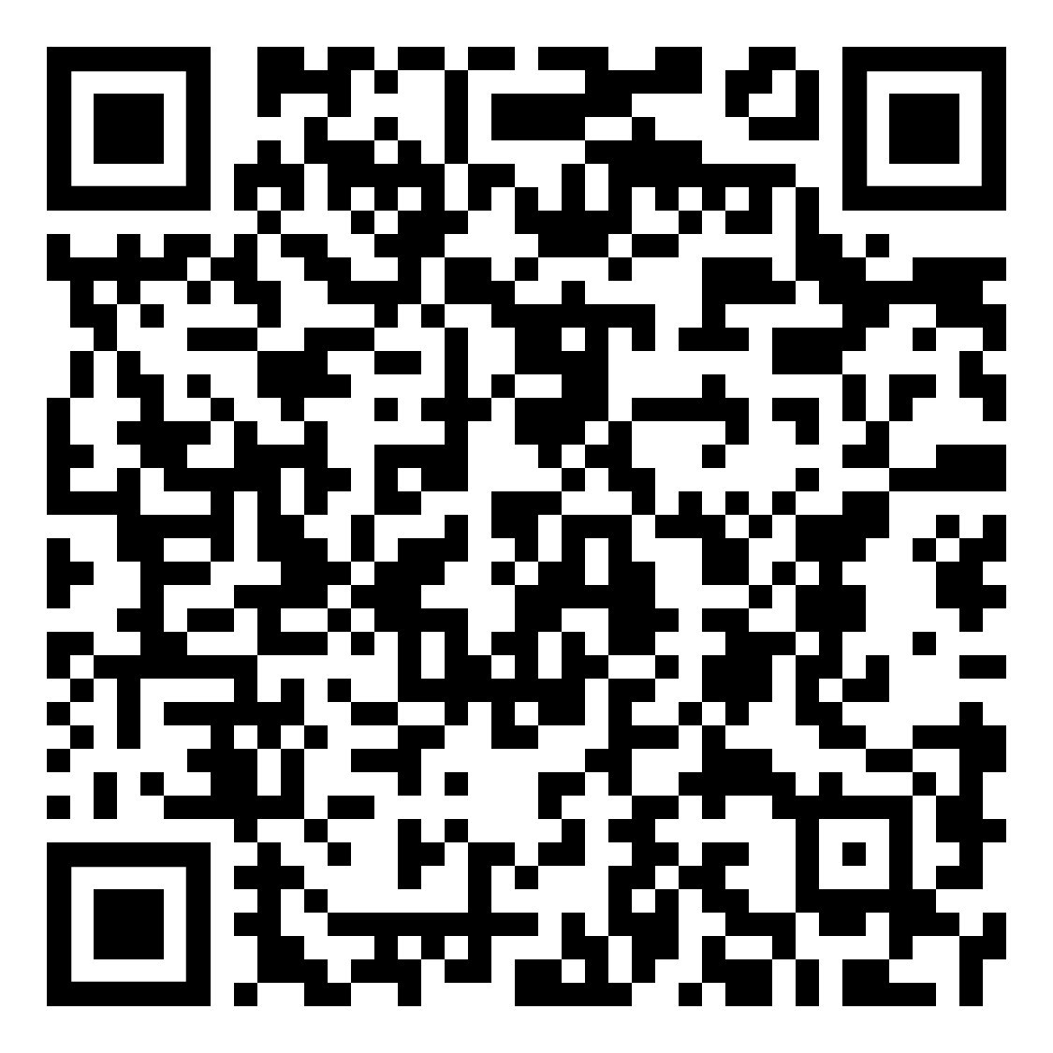
Federal Employees Group Life Insurance
FEGLI is term life insurance. It does not build any cash value.
There are no regularly scheduled open seasons to elect or increase FEGLI coverage. OPM schedules open seasons intermittently and rarely, and annuitants are not eligible (though certain compensationers are).
FEGLI Handbook:
Notes:
This Handbook is a great resource for all things FEGLI: https://www.opm.gov/healthcare-insurance/life-insurance/reference-materials/federalbooklet.pdf

Slide 75
Federal Employees Group Life Insurance
In order to carry any FEGLI coverage into retirement, you must have been covered for the five years prior to retirement
Annuitants can reduce or cancel FEGLI coverage at any time
If annuitant elects to reduce or cancel any part of FEGLI coverage, the election is irrevocable
Annuitants cannot increase coverage, even during open season

Slide 76
Federal Employees Group Life Insurance
Basic - Final salary rounded up to nearest 1,000 plus $2,000
Option A - Straight $10,000.
Option B - Final salary rounded up to nearest $1,000. Increased by up to 5 multiples.
Option C - Family: $5,000 spouse and $2,500 eligible children. Increased by up to 5 multiples .

Slide 77
Federal Employees Group Life Insurance
Basic – Final salary rounded up to nearest 1,000 plus $2000
Three choices at retirement:
75% Reduction – payout reduces 2% per month starting at age 65 (or at retirement if > 65) until it reaches 25%, then frozen. No premiums once it starts to reduce.
50% Reduction – payout reduces 1% per month starting at age 65 (or at retirement if >65) until it reaches 50%, then frozen. Premiums increase with age for life (unless annuitant switches to 75% reduction).
No Reduction – payout remains the same. Premiums increase with age for life unless annuitant switches to 75% reduction.
Notes:
The 75% reduction is the common election as it becomes free when the benefit reduction kicks-in. The other options can be cost prohibitive. If in doubt they can select the higher option as FEGLI can be reduced or cancelled at anytime.

Slide 78
Federal Employees Group Life Insurance
Option A - $10,000 benefit
The amount of Option A coverage automatically begins reducing at age 65, or retirement, if later.
The amount of coverage reduces by 2% ($200) each month until the amount has been reduced by 75%. Only 25% of the original amount ($2,500) is payable as a death benefit once the full reduction has been reached. No premiums once it starts to reduce.
There is no election other than whether to keep it.

Slide 79
Federal Employees Group Life Insurance
Option B - Final salary rounded to next $1,000. Up to 5 multiples.
At retirement, elect how many of your multiples you want to continue, and choose “no reduction” or “full reduction” at age 65 (or retirement, if later).
You may split elections among your multiples.
Full Reduction – the original value reduces by 2% each month for 50 months, at which time no benefits are payable. No premiums once it starts to reduce.
No Reduction – no reduction in coverage, but you will continue to pay premiums associated with your age group.

Slide 80
Federal Employees Group Life Insurance
Option C – Family: $5,000 spouse and $2,500 eligible children times up to 5 multiples
Elect how many of your multiples you want to continue and choose “no reduction” or “full reduction” at age 65 (or at retirement, if later).
Full Reduction – the value reduces by 2% of the original amount each month for 50 months, at which time no benefits are payable. No premiums once it starts to reduce.
No Reduction – no reduction in coverage, but you will continue to pay premiums appropriate to your age group.

Slide 81
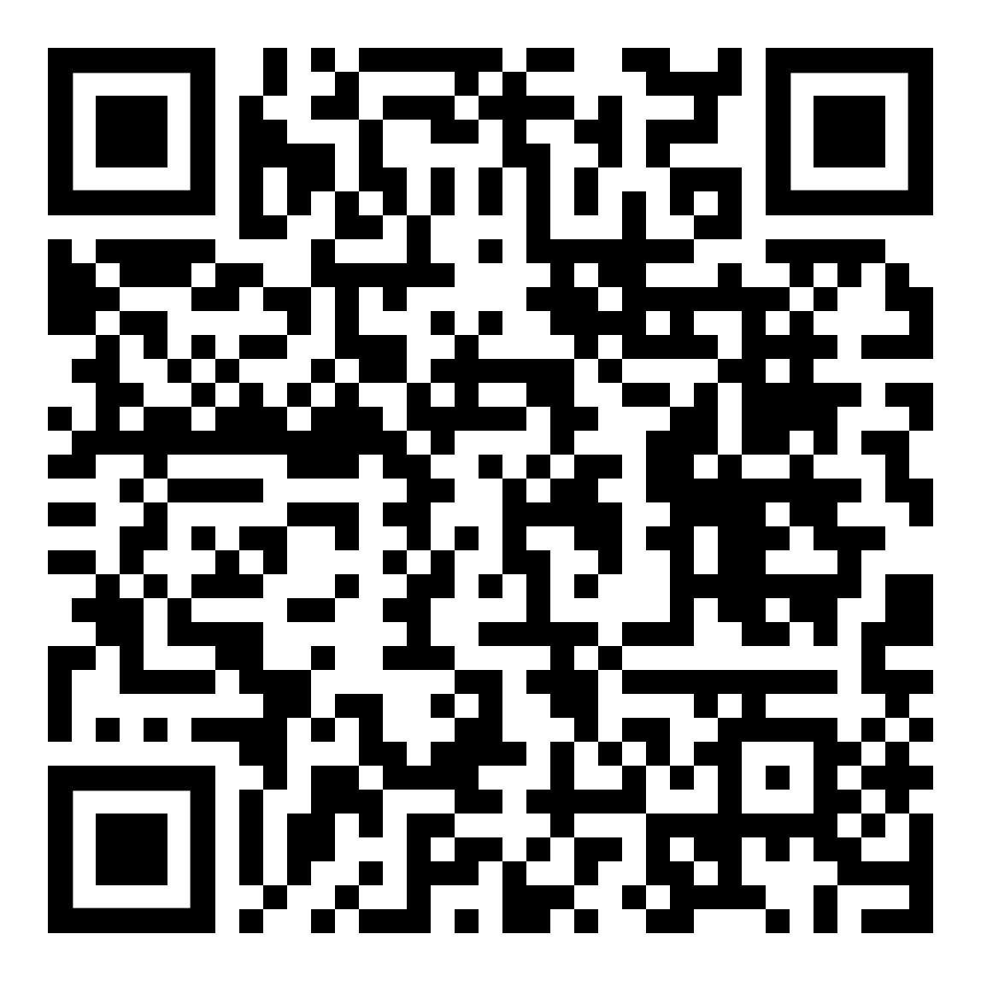
Federal Employees Group Life Insurance
Premiums for Annuitants
https://www.opm.gov/healthcare-insurance/life-insurance/program-information/#url=Premiums-for-Annuitants
FEGLI Calculator (continue through to calculate coverage following retirement)
https://www.opm.gov/retirement-center/calculators/fegli-calculator/

Slide 82
Mutual Benefit Association
Founded in 1891 by and for NALC members and their families
Designed to give members and their families the best possible protection for the lowest cost.
Many plans and options available.
Notes:
https://www.nalc.org/member-benefits/mutual-benefit-association

Slide 83
Mutual Benefit Association
Retirement Savings Plan
Annuities
Short-term Disability and Hospital Confinement
Whole Life
Term Life
Group Insurance available to branches
Notes:
Questions about the NALC Mutual Benefit Association should be directed to the MBA.

Slide 84
The Thrift Savings Plan (TSP) is administered by the Federal Retirement Thrift Investment Board (FRTIB). The Board is required by law to manage the TSP solely in the interest of TSP participants and their beneficiaries.
An Employee Thrift Advisory Council (ETAC) provides advice to the Board on investment policies and administration of the TSP.
Notes:
The point of this information is that the TSP is ran for the benefit of the employees. It is not a corporation trying to extract profit from its investors.

Slide 85
Employer Contributions
Agency Automatically contributes 1%
Matches first 3% dollar for dollar
Matches next 2% 50 cents on the dollar
Maximum: If employee contributes 5% (or more), the Postal Service will contribute 5%.
Those that don’t contribute at least 5% are missing out on employer contributions.
Notes:
https://www.tsp.gov/making-contributions/contribution-types/

Slide 86
New version of ‘My Account’ launched June 1, 2022. All participants must set up login credentials to this new system, even if they had access prior to June 1, 2022.
Create a username, password, and ThriftLine PIN to access your account. Prompts to verify your identity, update your contact information, and set up your account security.
Should take 5 to 10 minutes for most. You need to receive a one-time passcode to your phone by text message or voice call to verify your identity during the setup process.
www.tsp.gov

Slide 87
When you retire with a significant TSP balance, a host of financial planners, insurance salesmen, stockbrokers, bankers, hedge-fund operators, and the like are going to be very interested in that balance. They will try and convince you to take your money out of the TSP and invest it with them.
Notes:
We want to make the audience aware of snake oil salesman. Retirement accounts are a huge target.
See also the March 2020 Retirement column “Snake oil”
https://www.nalc.org/news/the-postal-record/2020/march-2020/document/DRM.pdf

Slide 88
What is the average net expense I will pay for every $1,000 I invest?
What additional annual fees, commissions, or charges will I pay for investments?
What profit do you make if I invest with you?
Do you have a responsibility (fiduciary obligation) to put my interests ahead of your own?
Will your plan protect my retirement from creditors’ claims?
When I retire, can I receive a series of scheduled withdrawals without giving up control of my account?
Can I change my investments or take withdrawals without being subject to surrender fees or back-end charges?
Notes:
These questions can help the retiree make decisions whether this is the type of financial planner/etc. that they want to do business with and help make a fully informed decision.

Slide 89
It costs money to operate any financial investment fund. A standard way to measure such costs to look at expense ratios.
The total expense ratio for TSP funds range from 0.043% to 0.059%.
Compare that with the average Net Expense Ratio of for-profit actively managed mutual funds of about 1.5 percent, or $15 per $1,000.
Thus, on average, a private investment fund would cost $3,000 per year, versus TSP costing $116 per year on an account balance of $200,000.
Notes:
12/8/22 https://www.tsp.gov/tsp-basics/administrative-and-investment-expenses/
Fees associated with securities lending are not included in 2018 administrative expenses. Consistent with standard practice in the industry, they are charged in addition to administrative expenses. Other expenses are disclosed in the financial statements and will be available in the April 2019 Highlights.
https://www.tsp.gov/keepingscore/index.html

Slide 90
Age 59 ½ early withdrawal penalty
If you receive a TSP withdrawal payment before you reach age 59 ½, in addition to the regular income tax, you may have to pay an early withdrawal penalty tax equal to 10% of any taxable portion of the payment that is not transferred or rolled over.
However, if you separate from service during or after the year you reach age 55, then the 10% early withdrawal penalty tax does not apply.

Slide 91
After separation you can:
leave your money in the TSP
transfer eligible money into your TSP (e.g., IRA)
continue to accrue earnings on your account
change your investment choices
Cannot make contributions
Notes:
Tax Rules about TSP payments https://www.tsp.gov/publications/tspbk26.pdf

Slide 92
After separation, there are three basic withdrawal options:
Installment payments
Monthly, quarterly, or annual
Fixed dollar amount or based on life expectancy
Partial or total distributions
Annuity purchases
You can choose any of these options or any combination
Withdrawals are subject to federal income tax

Slide 93
Required Minimum Distribution (RMD)
IRS requires RMDs beginning in the calendar year when you become age 73 (if you reach 73 in 2023 or later) and are separated from service.
If you do not start withdrawing by age 73 or the total amount of your withdrawals does not satisfy the RMD, TSP will disburse your RMD or issue a supplemental payment for the remaining amount of your RMD by the deadline each year.
If they automatically send you an RMD and you have both traditional and Roth balances, the RMD will be proportional from each balance.
Notes:
President signs SECURE 2.0 Act — On December 29, 2022, President Biden signed the Setting Every Community Up for Retirement Enhancement (SECURE) 2.0 Act of 2022 into law. SECURE 2.0 increases the start age for required minimum distributions from 72 to 73 in 2023 and then further increases the start age to 75 in 2033. We’re continuing to assess how SECURE 2.0 will affect the TSP and will provide updates as more details are finalized.

Slide 94
After you separate from service, you can take multiple post-separation partial withdrawals.
You’ll be able to choose whether your withdrawal should come from your Roth balance, your traditional balance, or a proportional mix of both.
You’ll be able stop, start, or make changes to your installment payments at any time.
You'll have enhanced online tools to help you make withdrawals in the My Account section of tsp.gov.

Slide 95
You can purchase a life annuity (a monthly benefit paid to you for life)
Single life annuity – with level or increasing payments
Joint life annuity with your spouse – with level or increasing payments, and with 100% or 50% survivor annuity
Joint life annuity with someone other than your spouse – with level payments, and with 100% or 50% survivor annuity
If joint annuitant other than your spouse is more than 10 years younger than you, you must choose a 50% survivor benefit, except in cases of former spouse court order

Slide 96
TSP Publications – Distributions
https://www.tsp.gov/forms/
Notes:
This handbook is a great resource, and each attendee should download a copy for their reference.

Slide 97
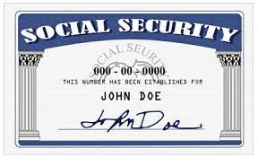
Social Security Administration
To create your own social security account online and get your estimate, go to:
https://www.ssa.gov/myaccount/

Slide 98
Social Security Administration
Can start receiving partial benefits as early as age 62.
Full benefits at Full Retirement Age (FRA).
If you start receiving early, your benefits will be reduced a small percent for each month before FRA.
Example – if you retire at 62 your benefit would be approximately 25% lower than if you waited until FRA.
Notes:
Reminder: Full Retirement Age (FRA) under Social Security should not be confused with FERS Minimum Retirement Age (MRA)

Slide 99
Social Security Administration
FRA depends on year of birth
Age | Year of birth
66 | 1943 – 1954
66 and 2 months | 1955
66 and 4 months | 1956
66 and 6 months | 1957
66 and 8 months | 1958
66 and 10 months | 1959
67 | 1960 and after

Slide 100
Social Security Administration
You may choose to keep working beyond your FRA. If so, you can increase your future Social Security benefits in two ways:
Each extra year of work adds another year of earnings to your Social Security record.
Your benefit will increase automatically by a certain percentage from the time you reach your full retirement age until you start receiving your benefits or until you reach age 70. The percentage varies depending on your year of birth.
For example, if you were born in 1943 or later, you’ll add 8 percent a year to your benefit for each year you delay signing up for Social Security beyond your full retirement age.

Slide 101
Social Security Administration
Earnings limitation – You can continue to work and still get retirement benefits. Social Security will reduce your benefits if your earnings exceed certain limits before you reach full retirement age:
The years before your FRA – SSA will deduct $1 in benefits for each $2 you earn above the annual limit ($21,240 for 2023).
In the calendar year you reach your FRA – SSA will reduce your benefits $1 for every $3 you earn over an annual limit ($56,520 for 2023) until the month you reach full retirement age.
Once you reach full retirement age, you can keep working and your benefit won’t be reduced no matter how much you earn.
Notes:
https://www.ssa.gov/news/press/factsheets/colafacts2023.pdf

Slide 102
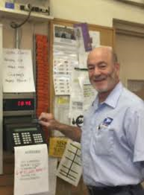
Joining the ‘Last Punch Bunch’
Decide what day to retire
Request annuity estimate & application
Other considerations & prep
Retirement counseling
Complete the forms
Send them in
Notes:
Here is what we are about to cover

Slide 103
Best day to retire
Once you are eligible to retire, you have the absolute right to decide when to retire. There may be financial considerations:
Entitlement to FERS annuity begins the first day of the month following the month in which you retire. Therefore, many letter carriers decide to retire the last day of a month.
Annual leave and sick leave are not credited if an employee does not remain employed for an entire pay period, so some decide to retire last day of a pay period to receive the leave.
Big picture: any day that ends in ‘Y’ is a good day to retire.
Notes:
CSRS can retire on the 1st, 2nd, or 3rd day of the month and begin entitlement. Otherwise entitlement starts at the beginning of the next month like FERS.
OPM computes years of service for determining amount of annuity in years and months. Days over a month are dropped. So some LCs decide to retire on a date that results in the total years of service computing to exact years and months, with no (or few) extra days.
Annual leave and sick leave are credited each pay period. But if an employee does not remain employed for an entire pay period, no AL or SL is credited. Neither AL nor SL is prorated for working part of a pay period. So some LCs decide to retire on the last day of a pay period.
The amount of the Special Annuity Supplement is computed based on years of service under FERS (not including military time, prior non-career federal service, saved sick leave, etc.) rounded to the nearest whole number. So some FERS retirees decide to retire on a date that results in years of FERS service being just over 6 months instead of just under six months.

Slide 104
Get your annuity estimate
Call USPS Shared Services and ask for annuity estimate based on desired retirement date.
Online at USPS LiteBlue for a quicker estimate.
Estimates do not bind you to retire.

Slide 105
Annuity Estimate
Notes:
This is what a mailed annuity estimate looks like. Next slides discusses what it contains.

Slide 106
Annuity Estimate
Check what retirement date the estimate is based on
Retirement Comp Date (RCD) is used to determine eligibility to retire and assumes all service listed on the service history report is accurate
Total Time = Total Actual Service plus Sick Leave
Used to determine annuity computation
Contains High-3 Average Salary
Includes estimates with and without a survivor annuity benefit
Includes special annuity supplement estimate
Notes:
The Retirement Computation Date (RCD) is used to determine eligibility for retirement. The RCD assumes all service listed on the attached Service History Report - career, non-career, military, USPS or other Federal Agency – is accurate. The Annuity Computation Date (ACD) reflects service for which FERS contributions are funded and therefore creditable for the computation of your annuity. The ACD does not include service for which FERS contributions were not made, or were made and refunded to you, but you did not complete a redeposit.

Slide 107
Request an Application
Call HRSSC (877) 477-3273 and ask for a retirement application.
It includes the necessary forms, each pre-printed at the top with your name and Employee Identification Number.
Formerly known as the ‘Blue Book’ - now with a white cover
When you receive the packet, call HRSSC back to schedule counseling.

Slide 108
Military Deposit
Deposit for military time, unlike deposit for prior non-career federal service, must be completed prior to retirement.

Slide 109
Flexible Spending Account (FSA)
Your period of participation ends the day after you retire.
You may file a claim for the expenses of services or items that were received prior to the day after your retirement.
Any services or items provided after your retirement date are not eligible for payment.
Claims for reimbursement of services or items received while still employed may be made until September 30 of the following year.
If you used your entire elected amount before it has been deducted from your pay, you will not be responsible for the remaining allotments.
Notes:
Source: https://www.fsafeds.com/support/faq/all?p=12

Slide 110
Uniforms
Payment to the vendor is not allowed if the following conditions exist:
The employee separates from the uniform program for any reason, including retirement, within 30 days following purchase of items of uniform wear that are not recognizable as distinctive uniform items unless worn with the basic outer garments of the uniform.
Nondistinctive items: shoes, gloves, rubbers, galoshes, overboots, hose, face masks, pith helmets, and belts.
When there is evidence that, before making the purchase, the employee indicated an intention to separate from the uniform program for any reason, including retirement…
See Employee and Labor Relations Manual Section 936.2

Slide 111
Official Personnel Folder
Official Personnel Folders (OPFs) contain important documents such as:
Health Benefits Program Registration
FEGLI Enrollment forms
Designations of Beneficiary
Form 50 history
Before you retire, save your eOPF. You will lose access immediately upon separation.
You will not be able to retrieve documents from USPS after separation.
Problems can arise with retirement that can be resolved easily if the retiree has these documents.

Slide 112
Retirement Counseling
Call USPS HRSSC and request a phone counseling session.
Session is on the clock if scheduled during tour of employee.
You have a right to have your spouse and/or advisor present at the session.
If the spouse/advisor is also a postal employee, they do not have a right to be on the clock.
You have a right to a private space for the session.
M-01708 in NALC’s Materials Reference System.
Notes:
http://mseries.nalc.org/M01708.pdf
Retirement Counseling ELM 589 https://about.usps.com/manuals/elm/html/elmc5_064.htm (CSRS provisions are found in Section 569)

Slide 113
Complete the Forms
The forms in the application book are preprinted with your name and employee ID number, which will help ensure efficient and problem-free processing.
Copy the forms so that a blank form is always available. Some of the forms are not valid if erasures, whiteouts or corrections are made.
Utilize the retirement counseling if you have questions about the forms.
Make copies of the completed forms for your records.

Slide 114
Certified Summary of Federal Service
Certified Summary of Federal Service
SF 3107-1 (FERS)
SF 2801-1 (CSRS)
This form will come blank. However, the form clearly asks you to review the information after the employing office completes and certifies the form. You are not required to sign this form (blank or completed).
If you request the Postal Service complete the form so that you can review it, and they refuse, talk to your shop steward. They can initiate a grievance prior to your separation. It doesn’t have to stop you from retiring. In this event, shop stewards should consult with the Retirement Department.
Notes:
Postal Record Contract Talk, Retirement Processing Issues (June 2018): https://www.nalc.org/news/the-postal-record/2018/june-2018/document/ct.pdf

Slide 115
Submit the Application
Send the completed forms to HRSSC / USPS. Ideally 60 days prior to separation.
After your last day, USPS will finalize their portion and send to OPM.
OPM will send you a CSA number and begin interim payments, usually without delay.
OPM makes annuity payments the first business day of the month. The payment is for the preceding month.

Slide 116
Interim Payments
While OPM processes your application and calculates your benefit, they will begin making interim payments
Computed at about 80% of estimated (net) annuity
Only federal income taxes are withheld
OPM will finalize your application
Typically takes 2-3 months
Begin paying your exact benefit with appropriate deductions
Will account for any back pay due to the interim payments
Notes:
Advise that retirees should have some money set aside when retiring incase their interim payments are insufficient to cover their expenses (or don’t start in a timely manner).

Slide 117
Post-Retirement
Terminal Leave Payments
Direct Deposit of Annuity
Post-Retirement Debt Collection
OPM Services Online
Cost of Living Adjustments
Federal Income Tax
Notice of Annuity Adjustment
NALC Membership
Notes:
These are topics that will be covered next

Slide 118
Terminal Leave Payments
Lump sum terminal leave payment includes:
accumulated AL up to maximum carryover
normally 440 hours, but expanded to 520 hours for 2023
any unused donated leave
holidays that fall within the terminal leave period (for FTRs and PTRs)
Leave in excess of the carryover will be forfeited
Any part of the unused AL earned during the leave year of separation that is in excess of the carryover is granted prior to separation. AL would need to be requested. See ELM 512.732b
Notes:
M-01979 changes carry over limit 520 into leave year 2023 – expires 12/31/2023
https://s3.amazonaws.com/mseries.nalc.org/M01979.pdf

Slide 119
Direct Deposit
OPM requires direct deposit of monthly annuity
Deposit can be to an account at a financial institution such as a credit union or bank
Or deposit can be to a Direct Express Card
Can be used to make purchases at stores or financial institutions that accept MasterCard. There are no fees for the deposit into the card each month, and no charge for using the card to make purchases.
Go to www.GoDirect.gov for information about fees and the surcharge-free network.

Slide 120
Post-Retirement Debt Collection
If you receive notice from USPS after separation that you owe money, immediately contact your branch and your NBA office. Two ways to appeal:
30-day time limit to appeal through the Debt Collection Act which requires USPS to provide appeal rights.
Or file a grievance which must be received at Step B within 30 days from the date the retiree first learned, or may reasonably have been expected to have learned, of the Postal Service’s intent to collect the debt.
If you do not timely appeal (or pay/make a payment plan), USPS will advise the U.S. Treasury, which will deduct the debt from your retirement, income tax, social security, etc., without any appeal rights. Treasury will add interest and penalties.
Notes:
This right was introduced with the 2016 – 2019 National Agreement.
It is found on page 217 of the 2019-2023 National Agreement.

Slide 121
OPM Services Online
Sign up!
www.servicesonline.opm.gov/
You need your CSA number and a temporary password, so you can’t sign up until you receive those from OPM.

Slide 122
OPM Services Online
View/print 1099-R tax forms
Change federal and state income tax withholding
View/print annuity statement and verification of income
View/print a year-to-date summary of payments
View/print verification of life insurance (FEGLI)
Change mailing address
Change password
View the status of case while in interim pay
Establish an allotment to an organization
Request duplicate annuity booklet
Set up a checking or savings allotment
Sign up for direct deposit of annuity payment
Update email address/opt-in to receive information electronically
View/print retirement services reference card (ID card)
Notes:
Functions that can be performed on Services Online

Slide 123
Federal Income Tax
Your annuity is subject to federal income tax. The total amount you contributed into the Civil Service Retirement and Disability Trust Fund over your working career, however, is tax sheltered, since that amount has already been subject to federal income tax.
Form 1099-R used to detail distributions from pensions.
Will be available by end of January each year. Mailed and on Services Online.
Includes Gross and Taxable amount.

Slide 124
Notice of Annuity Adjustment
OPM mails a hardcopy once a year if there is a change
e.g., COLA increase
Notice shows:
Gross
Deductions
Net
Survivor annuity is not listed as a deduction
The gross annuity is the amount after reduction for survivor annuity

Slide 125
Notice of Annuity Adjustment
Some deduction/addition codes used on the NOAA
Code | Deduction
04 | Union Dues
31 | Federal Tax
42 | Dental Insurance
45 | Letter Carrier Political Fund
46 | FEGLI Basic Life Insurance
67 | FERS Special Annuity Supplement

Slide 126
Maintaining NALC Membership
Article 2 Section 1(a):
Membership in the NALC shall be… retirees… who were regular members of the NALC when they retired…
Article 2 Section 1(e):
A Form 1189 (Dues Check-off Provision) must be signed by all retiring members within the NALC who wish to retain their membership… effective October 1, 1982.
Form 1189 must contain CSA number.

Slide 127
Maintaining NALC Membership
National Constitution Article 7(b):
A member who has retired from the Postal Service under the CSRS or FERS shall pay to the National Association $7 per annum…

Slide 128
Annual State Retiree Dues
State | Dues | State | Dues
Alabama | $4.00 | Florida | $5.10
Alaska | $0 | Georgia | $2.50
Arizona | $0 | Guam | $0
Arkansas | $0 | Hawaii | $0
California | $0.50 | Idaho | $0
Colorado | $0 | Illinois | $0
Connecticut | $0 | Indiana | $0
Delaware | $0 | Iowa | $0
D.C. | $5.00 | Kansas | $7.85
Notes:
In addition to the national dues for retirees, some states have the following dues. Some local’s also charge a small amount.
Membership costs for retirees are very small.

Slide 129
Annual State Retiree Dues
State | Dues | State | Dues
Kentucky | $0 | Montana | $0
Louisiana | $0 | Nebraska | $4.80
Maine | $0 | Nevada | $0
Maryland | $5.00 | New Hampshire | $0
Massachusetts | $1.25 | New Jersey | $1.00
Michigan | $0 | New Mexico | $0
Minnesota | $0 | New York | $3.60
Mississippi | $0 | North Carolina | $2.00
Missouri | $0 | North Dakota | $5.00

Slide 130
Annual State Retiree Dues
State | Dues | State | Dues
Ohio | $1.20 | Texas | $0
Oklahoma | $3.60 | Utah | $1.20
Oregon | $2.40 | Vermont | $0
Pennsylvania | $0.50 | Virginia | $6.00
Puerto Rico | $3.60 | Virgin Island | $0
Rhode Island | $0 | Washington | $7.20
South Carolina | $1.00 | West Virginia | $24.00
South Dakota | $0 | Wisconsin | $1.20
Tennessee | $2.00 | Wyoming | $0

Slide 131
Important Phone Numbers
USPS Shared Services: (877) 477-3273 option 5
NALC Retirement Dept: (202) 393-4695
Toll-free (800) 424-5186
Mon., Wed., Thur. 10-12 & 2-4 EST
National Business Agent:
Notes:
The QR code goes to nalc.org > regions so that participants can look up their NBA contact information.

Slide 132
More Information
Sign up to receive the Benefits Info listserv emails!
Log into the OPM webpage at:
http://apps.opm.gov/Listserv_Apps/list-sub.cfm

Slide 133
Legislative Attacks on Retirement
2012 Budget Proposal to reduce Social Security COLAs (not passed)
2012 House Resolution passed: Changes employee contributions from 7% to 12%, employer contributions from 7% to 2% (not passed by the Senate)
2013 Law changed FERS employee contributions from 0.8% to 3.1% (law passed!)
2014 Law changed FERS employee contributions from 3.1% to 4.4% (law passed!)
Notes:
Attacks on our retirement have come from both sides of the aisle. Letter carriers must stay engaged in politics to ensure we keep, and enhance, the benefits we derive through the law(s).

Slide 134
Legislative Attacks on Retirement
2018, 2019, 2020 Budget Proposals to:
change FERS employee contributions from 4.4% to 7.5%
change high-3 to high-5
eliminate FERS COLA
reduce CSRS COLA
eliminate FERS Special Annuity Supplement
reduce TSP G-Fund interest rate
Notes:
https://www.vox.com/2019/3/12/18261739/trump-budget-2019-federal-workers

Slide 135
Notes:
Participants will not be able to read this chart. Explain what the colors are and that the graph goes from 1990 to 2020.
Point out that the Civil Service Disability and Retirement fund has always grown, and projections show that will continue. Why do we need to cut benefits or increase the costs to hardworking federal employees?
See also: A brief history CSRS and FERS https://www.nalc.org/news/the-postal-record/2020/october-2020/document/DRM.pdf
Civil Service Disability and Retirement Fund has always shown a pattern of growth while all those cuts were proposed and/or implemented:
Data Source: Pages 13/14 of https://crsreports.congress.gov/product/pdf/RL/98-972

Slide 136
Social Security Fairness Act
H.R. 82 and S. 597
Repeals the Windfall Elimination Provision (WEP) and Government Pension Offset (GPO) that unfairly reduce benefits for Civil Service Retirement System annuitants
Notes:
118th Congress 2023-2024
NALC Fact Sheet: https://www.nalc.org/government-affairs/body/2023-WEP-and-GPO-fact-sheet-1.pdf
H.R. 82: https://www.congress.gov/bill/118th-congress/house-bill/82
S. 597: https://www.congress.gov/bill/118th-congress/senate-bill/597

Slide 137
Letter Carrier Political Fund
Fight Back!
Vote
Volunteer
Contribute
Note: By making a contribution to the Letter Carrier Political Fund, you are doing so voluntarily with the understanding that your contribution is not a condition of membership in the National Association of Letter Carriers or of employment by the Postal Service, nor is it part of union dues. You have a right to refuse to contribute without any reprisal. The Letter Carrier Political Fund will use the money it receives to contribute to candidates for federal office and undertake other political spending as permitted by law. Your selection shall remain in full force and effect until canceled. Contributions to the Letter Carrier Political Fund are not deductible for federal income tax purposes. Federal law prohibits the Letter Carrier Political Fund from soliciting contributions from individuals who are not NALC members, executive and administrative staff or their families. Any contribution received from such an individual will be refunded to that contributor. Federal law requires us to use our best efforts to collect and report the name, mailing address, occupation and name of employer of individuals whose contributions exceed $200 per calendar year. Any guideline amount is merely a suggestion, and an individual is free to contribute more or less than the guideline suggests and the union will not favor or disadvantage anyone by reason of the amount of their contribution or their decision not to contribute.

Slide 138
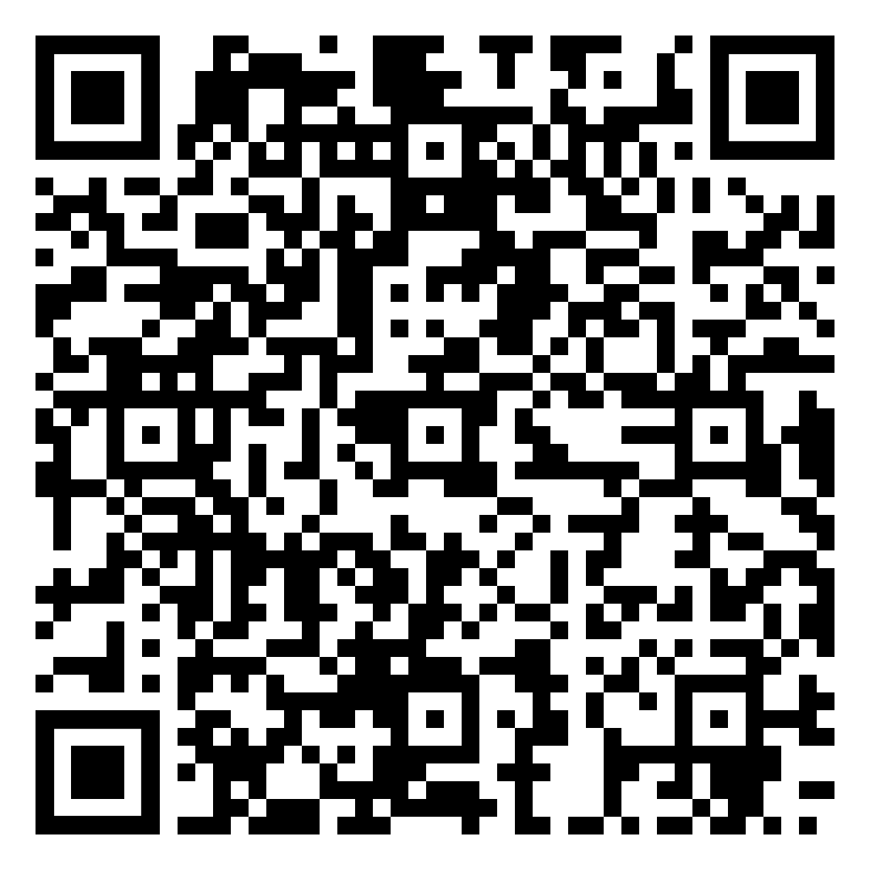
Letter Carrier Political Fund
Enroll by phone
Call the Retirement Department at (202) 393-4695
Enroll online
Log into Services Online, click ALLOTMENTS TO ORGANIZATIONS, select Letter Carrier Political Fund
Enroll by mail – download the form in the QR code
Notes:
Annuitant sign up form: https://www.nalc.org/government-affairs/political-activity/body/letter-carrier-political-fund-postalease-annuity-2.pdf
Letter Carrier Political Fund https://www.nalc.org/government-affairs/political-activity/yes-i-want-to-become-a-pac-member

Slide 139
Need More Information?
NALC.org Workplace Issues Retirement
Questions & Answers booklets
Retirement columns
COLA projections and updates
Phone numbers
OPM.gov Retirement
Questions and answers
CSRS and FERS Handbook for Personnel and Payroll Offices
The definitive rules and procedures to become a guru
Notes:
NALC Retirement https://www.nalc.org/workplace-issues/retirement
CSRS and FERS Handbooks https://www.opm.gov/retirement-center/publications-forms/csrsfers-handbook/

Slide 140
Notes:
Problems or ideas for this presentation? Feel free to contact the retirement department (202.393.4695) with suggestions.

