Slide 1
National Association of Letter Carriers
Retirement for City Letter Carriers
February 2026
Notes:
ALWAYS CHECK FOR THE LATEST VERSION @ https://www.nalc.org/workplace-issues/retirement

Slide 2
Agenda
Federal Employees Retirement System (FERS)
Civil Service Retirement System (CSRS)
Postal Service Health Benefits (PSHB)
Federal Employees Group Life Insurance (FEGLI)

Slide 3
Agenda cont.
Thrift Savings Plan (TSP)
Social Security Administration (SSA)
Other considerations
Applying
Post-retirement info

Slide 4


Federal Employees Retirement System
(FERS)
Applied to new hires on and after Jan. 1, 1984
Three components
  FERS Basic Benefit – a defined benefit plan
    Special Annuity Supplement
  Social Security
  Thrift Savings Plan – a defined contribution plan
Notes:
When Congress created FERS they intended for it to be in parity with CSRS (taking into account Social Security and TSP).
Defined benefit plans have become rare.

Slide 5

NALC Career Employment Statistics
January 2026:
  FERS 178,902 99.52%
  CSRS 868 0.48%
  Total 179,770
Notes:
Good time to see if any CSRS employees are in the room.

Slide 6

Cost
FERS is funded through employer and employee contributions. Employee contributes:
  FERS – Hired before Jan.1 2013 – 0.8%
  FERS RAE (Revised Annuity Employees) – Hired in 2013 – 3.1%
  FERS FRAE (Further Revised Annuity Employees) – Hired 2014 or later – 4.4%
Notes:
Emphasize that we are talking about FERS now.
Even with increases to employee contributions, the pension is still a good benefit.
Employer contributions vary. Currently, it’s approximately 17%.

Slide 7

Types of Retirement
Voluntary (regular / immediate)
  Based on age and service
Disability
Early (MRA + 10)
  Minimum retirement age with 10 years of service
  Can be postponed to reduce or eliminate age reduction
Deferred

Slide 8
Types of Retirement
Alternative Form of Annuity (AFA)
  Life-threatening affliction or other critical medical condition
Early Voluntary Retirement
  Due to a reduction-in-force (RIF)
Phased
  Not currently available to USPS employees
Notes:
Alternative Form of Annuity provides an option for those with a life-threatening affliction. The annuity will be permanently reduced and they will receive a lump-sum payment of their retirement contributions. If married the spouse will need to consent to the election.
https://www.opm.gov/retirement-center/publications-forms/pamphlets/ri38-123.pdf
The Postal Service has stated it will not implement phased retirement. Phased Retirement is a human resources tool that allows full-time employees to work part-time schedules while beginning to draw retirement benefits. This tool will allow managers to better provide unique mentoring opportunities for employees while increasing access to the decades of institutional knowledge and experience that retirees can provide.

Slide 9

Voluntary Retirement
This seminar focuses on voluntary retirement or “regular” retirement based on age and service that starts immediately after separation.
NALC members considering MRA + 10 (early), disability, or other types of retirement should obtain direct one-on-one advice from a branch officer, their NBA office, or the NALC HQ retirement department.

Slide 10
Minimum Retirement Age
(MRA)
If you were born: | Your MRA is:
Before 1948 | 55
1948 | 55 and 2 months
1949 | 55 and 4 months
1950 | 55 and 6 months
1951 | 55 and 8 months
1952 | 55 and 10 months
Notes:
FERS Minimum retirement age depends on the year of birth.

Slide 11
Minimum Retirement Age
(MRA)
If you were born: | Your MRA is:
1953 through 1964 | 56
1965 | 56 and 2 months
1966 | 56 and 4 months
1967 | 56 and 6 months
1968 | 56 and 8 months
1969 | 56 and 10 months
1970 and after | 57

Slide 12
When will I be eligible to retire?
Voluntary (optional/immediate) annuity eligibility:
Age | Years of Service
62 | 5
60 | 20
Minimum Retirement Age (MRA) | 30
Notes:
FERS Minimum Retirement Age (MRA) should not be confused with Social Security Full Retirement Age (FRA).

Slide 13
Creditable Service for Eligibility
For eligibility purposes, combine:
  FERS service
  Military service (if deposit made)
  Non-career service (if deposit made)
  Subtract LWOP in excess of six months in a calendar year
Notes:
Creditable Service for eligibility can be different than creditable service when calculating the annuity amount. It is important that the two are not confused.

Slide 14
Creditable Service
Sick Leave
Sick leave balance at retirement is added to the length of service to calculate the amount of an immediate annuity
Unused sick leave counts towards annuity calculation but does not count towards eligibility
Potential pitfall – retiring before eligibility because you erroneously counted sick leave could result in large and permanent reduction to annuity.

Slide 15
Creditable Service
LWOP
Cumulative leave without pay (LWOP) in excess of 6 months in a calendar year is not credited.
In other words, the first six months of cumulative leave without pay per calendar year is credited.
Exceptions: All LWOP is credited if due to:
  an on-the-job injury and wage loss compensation was paid by OWCP
  full-time union official employment and union pays employer contributions
  military furlough

Slide 16

Creditable Service
Part-time
In determining eligibility to retire, part-time service is creditable to the same extent as full-time service
All part-time service is prorated for annuity calculation
Notes:
Example – five years of part-time service (such as part-time flexible) will count as five years towards ELIGIBILITY. But if they worked less than 40 hours per week there would be an impact on their annuity calculation.
https://www.nalc.org/news/the-postal-record/2022/may-2022/document/DRM.pdf

Slide 17

Crediting Military Service
Must be:
  Active duty
  Discharged under honorable conditions
Military retired pay must be waived unless it is based on:
  A disability incurred in combat, or
  A reserve component of the Armed forces
National Guard service is creditable only in limited circumstances

Slide 18
Crediting Military Service
A deposit must be made for all military service performed after 1956 to receive credit for eligibility or towards annuity computation.
Deposit must be completed prior to separation.
Intermittent periods of military active duty, such as reservist activation, will be deducted from total service at retirement if no deposit was made.
  Beware: such intermittent periods of service won’t be flagged on your annuity estimate; without forewarning, this service time will be eliminated from your service record at retirement, when it’s already too late to make deposit.
Notes:
Unlike deposits for non-career civilian service, military deposits MUST be completed prior to separation for credit.

Slide 19
Crediting Military Service
Military deposit equals 3% of base military pay plus interest
  Interest does not start to accrue for the first two years of civilian service
Alternative method under USERRA
  Amount of deposit before interest is limited to the amount of civilian retirement deductions which would have been withheld
Notes:
Interest that starts to accrue for the third year does not become effective until the end of the year, so technically if the deposit is completed prior to the end of year 3 there will be no interest.
In any case, the recommendation is to make sure new hires are aware of making a deposit for military service if applicable.
https://www.opm.gov/retirement-center/benefits-officers-center/webcast-presentations/military-deposits.pdf

Slide 20
Making a Deposit for
Military Service
Call USPS Human Resources Shared Service Center (HRSSC)
  (877) 477- 3273 (option 5)
Complete SF 3108 Application to Make Service Credit Payment
Submit completed form with DD 214 or equivalent record to verify the service, as well as military earnings statements
Remember – the full deposit must be completed prior to separation. It is best to do so, however, upon hiring or immediately after performing military service to avoid paying interest
Notes:
They can begin the process of making a deposit. Then compare the benefits to the cost to make a fully informed decision.

Slide 21

Crediting Non-Career Federal Service
Service prior to 1989
  Credited only if deposit is made
Service on or after Jan. 1, 1989
  Not creditable without legislative action
    https://www.nalc.org/government-affairs
Cost – 1.3% of basic pay of the non-career service, plus interest
Notes:
Another reason to participate in politics: 118th Congress Federal Retirement Fairness Act (H.R. 5995) would have allowed deposits for civilian service after 1988 if it had passed into law.
https://www.nalc.org/government-affairs/legislative-activities/document/Federal-Retirement-Fairness-Act-2023.pdf
A note about the QR Code: participants can use a smartphone camera to access the link. Presenter may want to inform the audience how to use the QR code if necessary. These QR codes and links are also available on the handout.

Slide 22
Making a Deposit for Non-Career Service
Call USPS HRSSC: (877) 477- 3273 (option 5)
Complete SF 3108 Application to Make Service Credit Payment
Deposit can be made to USPS prior to separation or directly to OPM after separation.

Slide 23

Annuity Computation
Annuity Computation – Multiply:
  Years of Service
  High-3 Average Salary
  Factor (1.0% or 1.1%)
Notes:
This serves as an overview. We will explain each of these variables.

Slide 24
Annuity Computation
Length of Service
Years of Service – for annuity computation purposes
  Years under FERS, PLUS:
    military service (if deposit made)
    non-career federal service (if deposit made)
    banked sick leave
  MINUS LWOP in excess of six months in a calendar year
Notes:
RED FLAG: Letter Carriers with military reserve time that was not active service should be sure to verify their service credit on Form 3107-1 Certified Summary of Federal Service prior to retiring.
Military Reserve service during Weekly or Biweekly Training Periods is not active duty and therefore not creditable for CSRS/FERS purposes.
While the weekly and biweekly training sessions are reserve duty and not creditable, the annual 15-day training camp or cruise which reservists are called upon to attend (and for which they receive pay and allowances) is active duty and, therefore, creditable.
The Postal Service has on occasion not updated service history to deduct un-creditable military reserve time until letter carriers have retired.

Slide 25

Annuity Computation
Length of Service
Years of service
  Length of service is rounded down to the nearest month. Days short of a month (30 days) are dropped from the total.
  Example: 30 years, 2 months, and 17 days would result in 30 years and 2 months of service for computational purposes.

Slide 26

Annuity Computation
High-3 Average Salary
Highest three consecutive years of pay
  Typically, last three years for letter carriers
Base pay only
  Does not include overtime, night differential, bonuses
Nonpay status while on OWCP, union official, and periods of LWOP less than 6 months in a calendar year count
  Payrate found on PS Form 50
Notes:
Essentially, if the service is creditable for length of service, it is creditable towards your High-3 Average Salary.
High-3 average salary computations are based on periods of creditable service. Thus, periods of nonpay status of 6 months or less in a calendar year that fall within an employee’s average salary period are included in the calculation of the average salary using the rate of basic pay in effect during the period of nonpay status. For example, if a full-time employee whose annual rate of basic pay is $85,000 per year is placed in nonpay status for 3 months, that 3-month period would be credited in the average salary calculation using the $85,000 basic pay rate. (If the rate of basic pay changed to $86,500 per year after 2 months of the nonpay period, the first 2 months of the nonpay period would be credited in the average salary calculation using the $85,000 basic pay rate and the last month of the nonpay period would be credited in the average salary calculation using the $86,500 basic pay rate.)
https://www.opm.gov/policy-data-oversight/pay-leave/leave-administration/fact-sheets/effect-of-extended-leave-without-pay-lwop-or-other-nonpay-status-on-federal-benefits-and-programs/

Slide 27
Annuity Computation
High-3 Average Salary
Effective Date | Type of Increase | Amount
Aug. 26, 2023 | July COLA | $978
Nov. 18, 2023 | General wage increase | 1.3%
March 9, 2024 | January COLA | $353
Sept. 7, 2024 | July COLA | $978
Nov. 16, 2024 | General wage increase | 1.4%
Notes:
2023-2026 National Agreement raises
Part 1 of 2

Slide 28
Annuity Computation
High-3 Average Salary
Effective Date | Type of Increase | Amount
March 8, 2025 | January COLA | $416
June 14, 2025 | Step P adjustment | $1,000
Sep. 6, 2025 | July COLA | $790
Nov. 15, 2025 | General Wage Increase | 1.5%
March 7, 2026 | January COLA | TBD
Notes:
2023-2026 National Agreement raises
Part 2 of 2

Slide 29
Annuity Computation
High-3 Average Salary
From | To | Years | Months | Days | Annual Rate | Gross Pay
1/1/2023 | 3/10/2023 | 0 | 2 | 10 | $73,802.00 | $13,951.61
3/11/2023 | 8/25/2023 | 0 | 5 | 15 | $75,299.00 | $34,658.17
8/26/2023 | 11/17/2023 | 0 | 2 | 23 | $76,277.00 | $17,554.16
11/18/2023 | 3/8/2024 | 0 | 3 | 20 | $77,256.00 | $23,705.95
3/9/2024 | 9/6/2024 | 0 | 5 | 29 | $77,609.00 | $38,698.19
9/7/2024 | 11/15/2024 | 0 | 2 | 9 | $78,587.00 | $15,071.48
Notes:
FOR DEMONSTRATION PURPOSES ONLY.
Part 1 of 2

Slide 30
Annuity Computation
High-3 Average Salary
From | To | Years | Months | Days | Annual Rate | Gross Pay
11/16/2024 | 3/7/2025 | 0 | 3 | 20 | $79,641.00 | $24,437.79
3/8/2025 | 6/13/2025 | 0 | 3 | 6 | $80,057.00 | $21,494.76
6/14/2025 | 9/5/2025 | 0 | 2 | 23 | $81,057.00 | $18,654.21
9/6/2025 | 11/14/2025 | 0 | 2 | 9 | $81,847.00 | $15,696.68
11/15/2025 | 12/31/2025 | 0 | 1 | 16 | $82,976.00 | $10,684.58
High-3 Average Salary $78,202
Notes:
FOR DEMONSTRATION PURPOSES ONLY.
Part 2 of 2

Slide 31
Annuity Computation
Factor
1.0% is the default factor
1.1% if at least age 62 with 20 or more years of service at retirement
  This amounts to a 10% increase in the annuity
  A trade off to retiring before 62 and receiving the Special Annuity Supplement
  Potential pitfall: retiring right before age 62 with over 20 years of service. You don’t get the extra 10% and you minimize receipt of the Special Annuity Supplement.

Slide 32
Annuity Computation
Example
30 years total service, age 59
  1% x 30 years x High-3 = 30% of High-3 Average Salary
30 years total service, age 62
  1.1% x 30 years x High-3 = 33% of High-3 Average Salary

Slide 33

Early Retirement (MRA + 10)
Employee has MRA and at least 10 years of service but less than 30 (also does not have age 60 with ≥ 20 years of service) and begins receiving annuity before age 62.
Age reduction of 5% for each full year under age 62. PERMANENT.
NO Special Annuity Supplement.
Notes:
Age reduction – each month under 62 is 5/12 of a percent reduction.

Slide 34
Special Annuity Supplement
Intended to substitute for the Social Security part of the total FERS benefit until age 62
Paid by OPM, not Social Security
Subject to earnings test
No Cost-of-Living Adjustments
Ends at age 62 whether you start Social Security or not
Notes:
The supplement is an estimate of the amount of Social Security benefits earned during FERS civilian service.
The supplement ends on the earlier of the last day of the month in which the retiree becomes age 62 or the last day of the month before the first month for which the retiree would, upon proper application, be entitled to Social Security benefits.
https://www.opm.gov/retirement-center/publications-forms/csrsfers-handbook/c051.pdf Page 5

Slide 35
Special Annuity Supplement
Eligibility
  Must have at least one full calendar year of FERS service, and is based on full calendar years of FERS service*
  *When retiring at the end of December, make retirement date 12/31 so that that
  calendar year counts towards the Supplement
  Retiring voluntarily on an immediate annuity which is not reduced for age:
    MRA with at least 30 years of service
    Age 60 with at least 20 years of service
  Not eligible if retiring age 62 or later
Notes:
Not eligible: Disability retirees, individuals retiring under MRA+10, individuals who are eligible only for a deferred annuity, individuals retiring age 62 or later.

Slide 36
Special Annuity Supplement
Earnings Test
  Earnings are wages, including self-employment.
    Does not include investment gains, interest, pensions, TSP withdrawals, etc.
  Must report earnings each year to OPM.
  Exempt amount subject to change each year. Aligns with Social Security earnings limitation. Supplement is reduced by $1 for each $2 earned above the limit.
  2026 earnings limit is $24,480.
Notes:
[2025] Supplement would be reduced to zero when earnings are $70,200 or greater. https://www.ssa.gov/oact/cola/rtea.html

Slide 37
Special Annuity Supplement
Request an annuity estimate from the Postal Service (HRSSC)
  Remember, this is just an estimate. OPM will determine exact amount upon retirement.
Notes:
The Retirement Department often receives calls from members where the estimate was around $100 too high. If retiring in December, choose the 31st because only earnings for the full calendar year (from 01/01 to 12/31) will be included in your earnings history when calculating the Supplement. www.opm.gov/retirement-center/publications-forms/csrsfers-handbook/c051.pdf (page 6)

Slide 38

Maximum Annuity
There is no maximum annuity under FERS

Slide 39
Survivor Annuity
Annuity will be reduced to provide a survivor annuity if:
  Electing a survivor annuity for a spouse
  A former spouse is entitled to a survivor annuity based on a valid court order
  Electing to provide an insurable interest annuity
Important: a surviving spouse can continue PSHB coverage after an annuitant’s death ONLY if a survivor annuity election was made and the spouse was actively covered at the time of death.
Notes:
OPM sometimes takes months to begin survivor annuity. Retirees may want to ensure some savings are set aside to help the survivor bridge the gap.
https://www.opm.gov/support/retirement/faq/survivor-benefits/

Slide 40
Survivor Annuity
Cost
  Full survivor annuity costs 10% of annuity
    Provides a survivor annuity of 50%
  Partial survivor annuity costs 5% of annuity
    Provides a survivor annuity of 25%

Slide 41
Insurable Interest Annuity
Insurable interest is an insurance term which applies to someone who would reasonably expect to derive financial benefit from your continued life.
It is presumed to exist if you name as beneficiary of the insurable interest, any of the following individuals:
  a spouse; a blood or adopted relative closer than first cousins; an ex-spouse; a person to whom you are engaged to be married; or a person with whom you are living in a relationship that would constitute a common-law marriage in a jurisdiction that recognizes common-law marriages.

Slide 42
Insurable Interest Annuity
If insurable interest annuity is for a person not just listed, an affidavit is required to provide additional information about relationship, and financial dependency.
Cost increases based on age difference. From 10% annuity reduction to 40% when named person is 30 or more years younger.
Notes:
For more info: https://www.opm.gov/faq/retire/What-is-an-insurable-interest-survivor-benefit-election.ashx

Slide 43
Death of an Active Employee
If employee has at least 10 years of creditable service (18 months of which being civilian service) and died while subject to FERS deductions, a survivor annuity of 50% is payable if:
  Married for at least 9 months, or
  The employee’s death was accidental, or
  There was a child born of the marriage
Notes:
Providing this information so that no one feels obligated to retire to ensure a survivor annuity.

Slide 44
Cost of Living Adjustments
COLAs
Not applied under age 62
  Exception for disability and survivor annuitants
The first COLA is prorated
  However, annuitants that are not eligible to receive a COLA during their first year or more will receive the full amount after becoming eligible.
Notes:
If an employee retires at 61 years and 1 month old and are 62 by December when the COLA kicks in, they will get the PRORATED amount (ineligible for less than 1 year).
If an employee retires at 60 years and are 62 by December when the COLA kicks in, they will get the FULL COLA (was ineligible for 1 year or more).

Slide 45
Cost of Living Adjustments
If the change in the CPI-W is: | The COLA equals:
0 – 2 % | The CPI-W increase
2 – 3 % | 2.0 %
Greater than 3 % | CPI-W increase minus 1%
Notes:
If an employee retires at 61 years and 1 month old and are 62 by December when the COLA kicks in, they will get the PRORATED amount (ineligible for less than 1 year).
If an employee retires at 60 years and are 62 by December when the COLA kicks in, they will get the FULL COLA (was ineligible for 1 year or more).

Slide 46
Enhanced Annuity
Extra benefit for those injured on the job and receiving wage loss compensation (WLC) for at least two months total
  While on WLC cannot contribute to Social Security or Thrift Savings Plan
  Law passed in 2003 to offset these losses

Slide 47
Enhanced Annuity
Must have at least two months of cumulative LWOP while receiving WLC
Continuation of Pay not included (still making TSP and Social Security contributions)
No action required to receive the enhanced annuity
  Should be automatic and will be built into gross annuity

Slide 48
Enhanced Annuity
Provides an additional one (1) percent for the length of OWCP-LWOP time towards annuity
Example: 13 months of LWOP while receiving WLC is 1 and 1/12 or 1.083 percent in addition to the regular annuity computation
Applies to FERS only

Slide 49

Civil Service Retirement System
CSRS
  Effective 1920
  A defined benefit plan – you get a guaranteed amount in retirement no matter what the stock market does
The following slides will discuss the differences of CSRS from FERS.
Notes:
CSRS portion goes through slide 60. Skip to slide 61 if not covering CSRS.
Make sure to emphasize that we are now talking about CSRS instead of FERS.

Slide 50

Eligibility
Immediate retirement eligibility:
Age | Service
55 | 30 years
60 | 20 years
62 | 5 years
Notes:
You must meet both the age and service requirements outlined in this slide for an immediate retirement benefit.
Once you meet these requirements you can retire at any time.

Slide 51
Creditable Service
In determining eligibility to retire, part-time service is creditable to the same extent as full-time service
Part-time service for annuity calculation:
  Prior to 4/7/86 is treated same as full-time
  On and after 4/7/86 is prorated
Notes:
ELM 582.3 Part-Time Service
Retirement benefits that include part-time employment will be prorated by a ratio of the part-time hours worked to the number of hours a full-time employee would have worked.
Compute the actual time worked, and the number of full-time hours that could have been worked, for all periods of part time service (performed on or after April 7, 1986 for CSRS).
Include time worked in excess of the scheduled part-time tour of duty, not to exceed full-time credit, in the computation of the actual time worked.
Include periods of creditable time in a nonpay (LWOP) status in the computation of actual time worked. The "actual time worked" during nonpay status is based on the tour of duty in effect immediately before entry into the nonpay status.
Divide the total actual hours worked by the total full-time hours to obtain the CSRS proration factor (round to the nearest percent).
You can request an annuity estimate from USPS Shared Services that includes calculation of part time service.
See section 5 of the Blue Book – General retirement information Question 4 in the CSRS book, question 11 in the FERS book:
The high-3 calculation for part-time employees may differ; such employees may request a NARECS annuity estimate through the HR Shared Service Center and the high-3 amount will be shown on it

Slide 52
Military Service
Military Service prior to Jan. 1, 1957, is creditable for retirement eligibility and computation, without making deposit
Military Service on or after Jan. 1, 1957, may be creditable based on various factors, including whether deposit has been made prior to separation

Slide 53
Post-1956 Military Service
If first employed under CSRS on or after 10/01/82
  must make deposit to obtain credit for eligibility and calculation

Slide 54
Post-1956 Military Service
If first employed in a position covered by CSRS before 10/01/82:
  If retiring prior to age 62, may receive credit without making deposit
    If no deposit is made, annuity will be reduced at age 62, if the retiree is eligible for Social Security benefits; this is called “Catch 62”. If the retiree is not eligible for Social Security benefits at age 62, there is no reduction in annuity.
  If retiring on or after age 62, can receive credit for purposes of annuity calculation if eligible for Social Security benefits only if deposit was made
    The military service may be creditable for establishing eligibility to retire even if no deposit is made.

Slide 55
Military Service
Cost of deposit
  Military deposit equals 7% of base military pay plus interest
  Interest does not start to accrue for the first 2 years of civilian service
Full deposit must be made to USPS prior to separation
Process:
  Call USPS Shared Services (877) 477-3273 (option 5)
  Complete and submit SF 2803 Application to Make Deposit or Redeposit
  Include DD 214 and military earnings statements
Notes:
Let them know that even if they are or will max out at 41 years and 11 months, it may still be beneficial to complete a deposit. See the April 2021 Retirement Column:
https://www.nalc.org/news/the-postal-record/2021/april-2021/document/DRM.pdf
They should start the process to weigh the cost of the deposit versus the benefits to make a fully informed decision.

Slide 56
Crediting Non-Career Service
Service prior to Oct. 1, 1982
  Credited for eligibility and computation
    but annuity reduced by 10% of amount of deposit due if deposit not made
Service on or after Oct. 1, 1982
  Credited for eligibility automatically
  Credited for computation only if deposit is made

Slide 57
Crediting Non-Career Service
Cost of deposit
  Generally, 7% of the basic pay of the non-career service, plus interest
The process to make a deposit
  Call USPS HRSSC (877) 477-3273 (option 5)
  Complete SF 2803 Application to Make Deposit or Redeposit
Deposit for non-career service can be made to USPS prior to separation or directly to OPM after separation.
Notes:
They should start the process to weigh the cost of the deposit versus the benefits to make a fully informed decision.

Slide 58
Annuity Calculation
High-3 Average Salary multiplied by:
  1.5 % for each of the first 5 years
  PLUS 1.75% for the next 5 years
  PLUS 2% for each year over 10

Slide 59
Annuity Calculation
Maximum annuity is 80% of the high-3 average salary
  Equivalent to 41 years and 11 months of service
Maximum of 80% can be exceeded with sick leave credit
Working beyond the maximum
  Employee continues to make CSRS contributions, but they will be returned with interest after separation

Slide 60
Survivor Annuity
Full survivor annuity – 55% benefit
Partial survivor annuity – can elect a base less than a full survivor annuity, even one as low as $1 and that will keep the surviving spouse eligible to continue health benefits
Cost depends on the base elected:
  2.5% of the first $3,600 of the base
  10% of the amount in excess of $3,600
Notes:
EXAMPLE 1: "Full" Survivor Benefits
Annuity $45,000
Base Selected $45,000
Amount up to $3,600 $3,600 x .025 = $90
Amount over $3,600 $41,400 x .10 = $4,140
Total Reduction $4,230
Reduced Annuity = $45,000 - $4,230 = $40,770
EXAMPLE 2: Less Than Full Survivor Benefit
Annuity $45,000
Base Selected $15,000
Amount up to $3,600 $3,600 x .025 = $90
Amount over $3,600 $11,400 x .10 = $1,140
Total Reduction $1,230
Reduced Annuity = $45,000 - $1230 = $43,770

Slide 61
Retirement Dates
Once you are eligible to retire, you have the absolute right to decide when to retire. There may be financial considerations:
Under CSRS you can retire on the last day of the month or one of the first three days of a month and annuity commences the following day.
Annual leave and sick leave are credited each pay period.
  Not prorated if not employed for an entire pay period. That is why some decide to retire on the last day of a pay period.
Notes:
OPM computes years of service for determining amount of annuity in years and months. Days over a month are dropped. So, some LCs decide to retire on a date that results in the total years of service computing to exact years and months, with no (or few) extra days.
Annual leave and sick leave are credited each pay period. But if an employee does not remain employed for an entire pay period, no AL or SL is credited. Neither AL nor SL is prorated for working part of a pay period. So, some LCs decide to retire on the last day of a pay period.

Slide 62
Cost-of-Living Adjustments
Begins the first December after retirement
First COLA will be prorated
Equals the percent change in the Consumer Price Index (CPI-W)
Notes:
Common misconception: The COLAs only ‘kick-in’ every December. They don’t ‘kick-in’ just because you retire or turn 62 and were (otherwise) eligible for the previous COLA. Must be eligible in December when the COLA is applied.
(If annuity commences December of the previous year, they would be prorated 12 months / 12 or 100% of the COLA)

Slide 63

Health Benefits

Slide 64

Postal Service Health Benefits
Information from the Office of Personnel Management
www.opm.gov
  Plan brochures
  Comparison tools
  Questions & Answers

Slide 65

Postal Service Health Benefits
The Postal Service Health Benefits (PSHB) Program started Jan. 1, 2025
PSHB is a subset of the Federal Employees Health Benefit (FEHB) Program

Slide 66
Postal Service Health Benefits
In order to carry your PSHB coverage into retirement, you must be eligible to retire on an immediate annuity (including the FERS MRA + 10 retirement); and
5-year rule: You must have been continuously enrolled (or covered as a family member) in any PSHB/FEHB plan(s) for the 5 years of service immediately before the date your annuity starts
  or for the full period(s) of service since your first opportunity to enroll, if less than 5 years
Notes:
If one is eligible for an immediate annuity but postpones the start of their benefits to lower the age reduction penalty, they can get back into PSHB when their annuity commences.

Slide 67
Postal Service Health Benefits
The 5-year requirement period can include the following:
  the time you are covered as a family member under another person's FEHB/PSHB enrollment; or
  the time you are covered under the Uniformed Services Health Benefits Program (also known as TRICARE) as long as you were covered under a FEHB/PSHB enrollment at the time of your retirement.
NOTE: a surviving spouse can continue PSHB coverage after an annuitant’s death only if a survivor election was made and the spouse was actively covered at the time of death.
Notes:
Important to point out that the surviving spouse must receive a survivor annuity to continue PSHB coverage. Some people elect not to leave a survivor annuity without realizing the health insurance consequences.

Slide 68

Postal Service Health Benefits
Deferred Retirement
  If you separated from Federal service before you could retire you are not eligible to enroll in PSHB when you start to receive your deferred annuity.

Slide 69

Postal Service Health Benefits
Postponed Retirement under FERS
  If you are eligible for an immediate retirement and otherwise eligible to continue coverage into retirement at the time of separation, you will be eligible to reenroll for health benefits and life insurance coverage when you begin to receive your postponed annuity.

Slide 70
Postal Service Health Benefits
Most letter carriers maintain PSHB coverage in retirement because USPS continues to pay a large share of the premiums (about 72%).
Retirees have the same open season opportunities as active employees.

Slide 71
Postal Service Health Benefits
Generally, decisions to drop PSHB coverage are irrevocable.
  Certain circumstances permit suspension (as opposed to termination) of FEHB enrollment: enrolling in Medicare Advantage, TRICARE, CHAMPVA, or Medicaid.
If you cancel your PSHB to be covered as a family member under another person’s PSHB enrollment, you are eligible to reenroll if you lose coverage under the other person’s enrollment as long as you were eligible to carry coverage at retirement. To reenroll, you must contact OPM within the period beginning 31 days before and ending 60 days after your loss of other PSHB coverage.
Notes:
There is a difference between suspending coverage (if eligible) and terminating coverage.

Slide 72
Postal Service Health Benefits
Required to enroll in Medicare Parts A and B (when eligible) if maintaining PSHB in retirement
Exceptions:
  Retired on or before Jan. 1, 2025
  Active employees at least 64 years of age as of Jan. 1, 2025
  Living outside of the United States and its territories
  Enrolled in certain health benefits through the Department of Veterans Affairs (VA) or from the Indian Health Service (IHS)
Notes:
https://www.nalc.org/news/the-postal-record/2022/july-2022/document/DRM.
There are exceptions for those enrolled in TRICARE (though TRICARE may have its own requirements to enroll in Part B), Indian Health Services, or for those that reside outside of the USA.

Slide 73
Postal Service Health Benefits
Health care is an important personal choice, consider:
  How your health insurance interacts with Part B
  Costs and benefits
  You can’t predict the future

Slide 74

Federal Employees Group Life Insurance
(FEGLI)

Slide 75
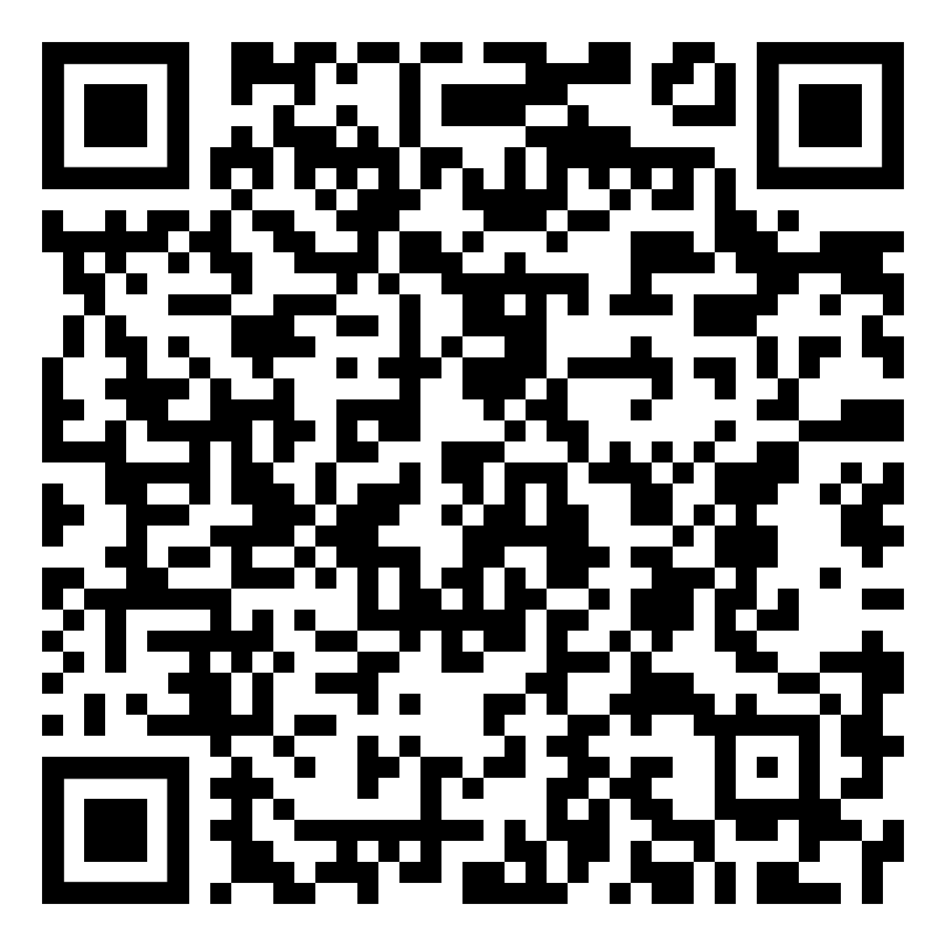
Federal Employees Group Life Insurance
FEGLI is term life insurance. It does not build any cash value.
There are no regularly scheduled open seasons to elect or increase FEGLI coverage. OPM schedules open seasons intermittently and rarely. Annuitants are not eligible to participate in open season (though certain compensationers are).
FEGLI Handbook:
Notes:
This Handbook is a great resource for all things FEGLI: https://www.opm.gov/healthcare-insurance/life-insurance/reference-materials/federalbooklet.pdf

Slide 76
Federal Employees Group Life Insurance
In order to carry any FEGLI coverage into retirement, you must have been covered for the five years prior to retirement
Annuitants can reduce or cancel FEGLI coverage at any time
If annuitant elects to reduce or cancel any part of FEGLI coverage, the election is irrevocable
Annuitants cannot increase coverage, even during open season

Slide 77
Federal Employees Group Life Insurance
Basic - Final salary rounded up to nearest 1,000 plus $2,000
Option A - $10,000
Option B - Final salary rounded up to nearest $1,000. Increased by up to 5 multiples
Option C - Family: $5,000 spouse and $2,500 eligible children. Increased by up to 5 multiples

Slide 78
Federal Employees Group Life Insurance
Basic – Final salary rounded up to nearest $1,000 plus $2000
Three choices at retirement:
  75% Reduction – payout reduces 2% per month starting at age 65* until it reaches 25%, then frozen. No premiums once it starts to reduce.
  50% Reduction – payout reduces 1% per month starting at age 65* until it reaches 50%, then frozen. Premiums increase with age for life.
  No Reduction – payout remains the same. Premiums increase with age for life unless annuitant switches to 75% reduction.
  *or at retirement if later
Notes:
The 75% reduction is the common election as it becomes free when the benefit reduction kicks-in. The other options can be cost prohibitive. If in doubt they can select the higher option as FEGLI can be reduced or cancelled at anytime.

Slide 79
Federal Employees Group Life Insurance
Option A - $10,000 benefit
  The amount of Option A coverage automatically begins reducing at age 65, or retirement if later.
  The amount of coverage reduces by 2% ($200) each month until the amount has been reduced by 75%. Only 25% of the original amount ($2,500) is payable as a death benefit once the full reduction has been reached. No premiums once it starts to reduce.

Slide 80
Federal Employees Group Life Insurance
Option B
  Final salary rounded to next $1,000. Up to 5 multiples.
  At retirement
    Elect number of multiples you want to continue
    choose “no reduction” or “full reduction” at age 65*
    You may split elections among your multiples
    *or at retirement if later

Slide 81
Federal Employees Group Life Insurance
Option B
  Full Reduction – the original value reduces by 2% each month for 50 months, at which time no benefits are payable. No premiums once it starts to reduce.
  No Reduction – no reduction in coverage, but you will continue to pay premiums associated with your age group.

Slide 82
Federal Employees Group Life Insurance
Option C – Family
  $5,000 spouse and $2,500 for eligible children
    up to 5 multiples
  At retirement:
    Elect number of multiples you want to continue
    Choose “no reduction” or “full reduction” at age 65*
    You may split elections among your multiples
    *or at retirement if later
Notes:
https://www.opm.gov/healthcare-insurance/life-insurance/reference-materials/federalbooklet.pdf
Eligible family members for Option C include a spouse (including a spouse from a valid common law marriage) and eligible dependent children. To be eligible, dependent children must be unmarried and under age 22, or if age 22 or over, incapable of self-support because of a mental or physical disability that existed before the child reached age 22. Eligible dependent children include your natural children, adopted children, stepchildren who live with you in a regular parent-child relationship, recognized natural children, and foster children (if they live with you in a regular parent-child relationship). Grandchildren are not covered unless they qualify as foster children. Stillborn children are not covered.
If you have any questions about eligible family members, please consult your human resources office; that office is responsible for determining eligibility

Slide 83
Federal Employees Group Life Insurance
Option C – Family
  Full Reduction – the value reduces by 2% of the original amount each month for 50 months, at which time no benefits are payable. No premiums once it starts to reduce.
  No Reduction – no reduction in coverage, but you will continue to pay premiums appropriate to your age group.

Slide 84
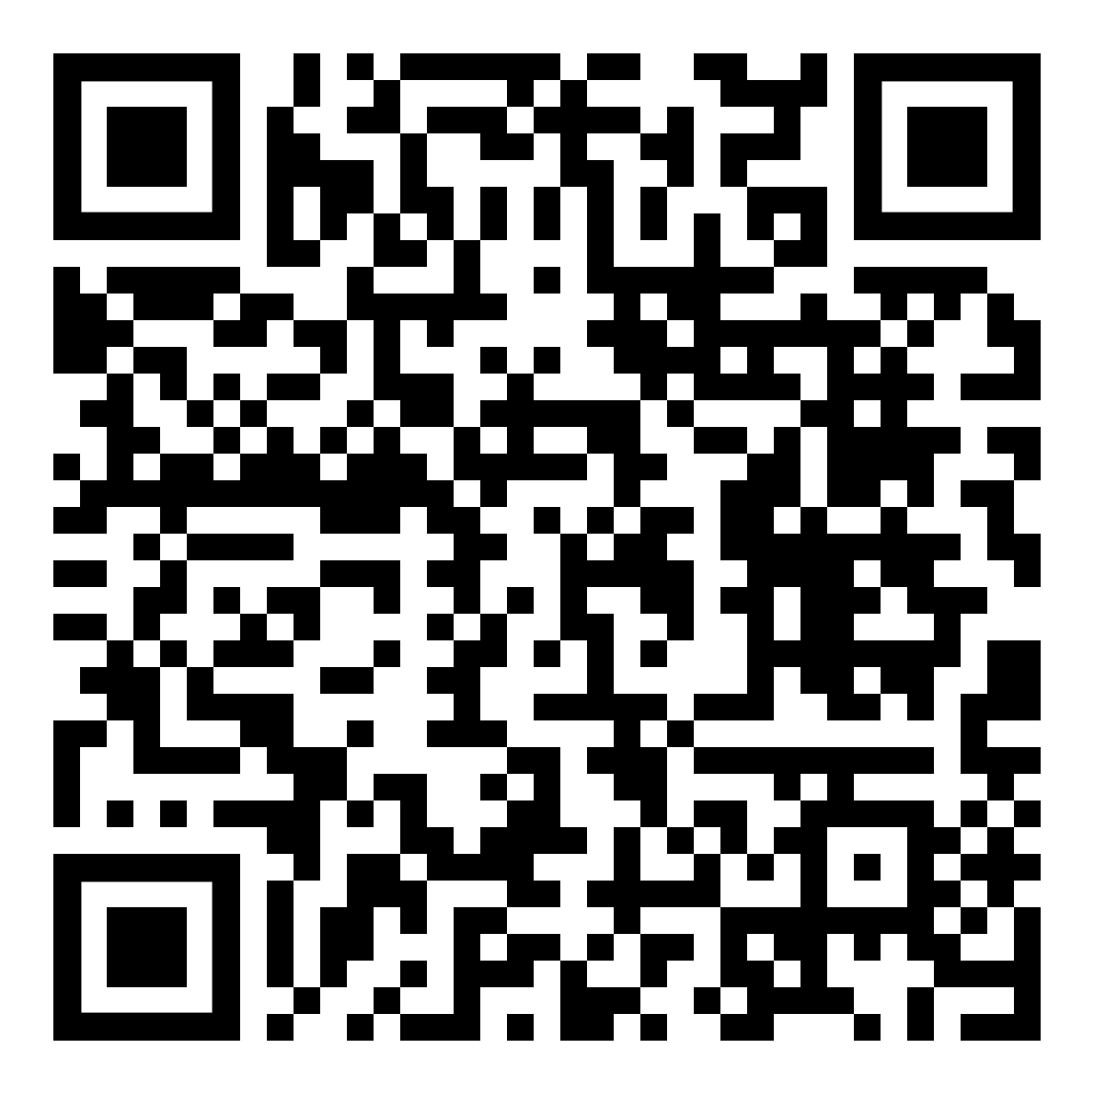
Federal Employees Group Life Insurance
Premiums for Annuitants
  https://www.opm.gov/healthcare-insurance/life-insurance/program-information/#url=Premiums-for-Annuitants
FEGLI Calculator (continue through to calculate coverage following retirement)
  https://www.opm.gov/retirement-center/calculators/fegli-calculator/

Slide 85

Mutual Benefit Association
Founded in 1891 by and for NALC members and their families
Designed to give members and their families the best possible protection for the lowest cost.
Many plans and options available.
Notes:
https://www.nalc.org/member-benefits/mutual-benefit-association

Slide 86

Mutual Benefit Association
Retirement Savings Plan
Annuities
Short-term Disability and Hospital Confinement
Whole Life
Term Life
Group Insurance available to branches
Notes:
Questions about the NALC Mutual Benefit Association should be directed to the MBA.

Slide 87

The Thrift Savings Plan (TSP) is administered by the Federal Retirement Thrift Investment Board (FRTIB). The Board is required by law to manage the TSP solely in the interest of TSP participants and their beneficiaries.
An Employee Thrift Advisory Council (ETAC) provides advice to the Board on investment policies and administration of the TSP.
Notes:
The point of this information is that the TSP is ran for the benefit of the employees. It is not a corporation trying to extract profit for its investors.

Slide 88
Employer Contributions
  Agency Automatically contributes 1%
  Matches first 3% dollar for dollar
  Matches next 2% 50 cents on the dollar
Maximum: If employee contributes 5% (or more), the Postal Service will contribute 5%.
Those that don’t contribute at least 5% are missing out on employer contributions.
Notes:
https://www.tsp.gov/making-contributions/contribution-types/

Slide 89
TSP ‘My Account’
  Create a username, password, and ThriftLine PIN to access your account. Prompts to verify your identity, update your contact information, and set up your account security.
  Should take 5 to 10 minutes for most. You need to receive a one-time passcode to your phone by text message or voice call to verify your identity during the setup process.
  www.tsp.gov

Slide 90

When you retire with a significant TSP balance, a host of financial and retirement planners, insurance salesmen, stockbrokers, bankers, hedge-fund operators, and the like are going to be very interested in that balance. They will try and convince you to take your money out of the TSP and invest it with them.
Notes:
We want to make the audience aware of snake oil salesman. Retirement accounts are a huge target.
See also the March 2020 Retirement column “Snake oil”
https://www.nalc.org/news/the-postal-record/2020/march-2020/document/DRM.pdf

Slide 91
What is the average net expense I will pay for every $1,000 I invest?
What additional annual fees, commissions, or charges will I pay for investments?
What profit do you make if I invest with you?
Do you have a responsibility (fiduciary obligation) to put my interests ahead of your own?
Notes:
These questions can help the retiree make decisions whether this is the type of financial planner/etc. that they want to do business with and help make a fully informed decision.

Slide 92
Will your plan protect my retirement from creditors’ claims?
When I retire, can I receive a series of scheduled withdrawals without giving up control of my account?
Can I change my investments or take withdrawals without being subject to surrender fees or back-end charges?
Notes:
These questions can help the retiree make decisions whether this is the type of financial planner/etc. that they want to do business with and help make a fully informed decision.

Slide 93
It costs money to operate any financial investment fund. A standard way to measure such costs is to look at expense ratios.
The total expense ratios for TSP funds range from 0.036% to 0.051%.
  $0.36 to $0.51 per $1,000.
Compare that with the expense ratio of for-profit actively managed mutual funds (0.5% to 0.75% is considered reasonable).
  $5 per $1,000.
10 x
Notes:
11/14/25 https://www.tsp.gov/tsp-basics/expenses-and-fees/ based on 2024 numbers
1/21/25 https://www.investopedia.com/ask/answers/032715/when-expense-ratio-considered-high-and-when-it-considered-low.asp#:~:text=Key%20Takeaways&text=A%20reasonable%20expense%20ratio%20for,typically%20considered%20high%20these%20days.
A reasonable expense ratio for an actively managed portfolio is about 0.5% to 0.75%, while an expense ratio greater than 1.5% is typically considered high these days.

Slide 94
Age 59 ½ early withdrawal penalty
If you receive a TSP withdrawal before age 59 ½ and are still working, in addition to the regular income tax, you may have to pay an early withdrawal penalty tax equal to 10% of any taxable portion of the payment that is not transferred or rolled over.
If you separate from service during or after the year you reach age 55, then the 10% early withdrawal penalty tax generally does not apply.
Notes:
https://www.tsp.gov/publications/tspbk26.pdf
Early Withdrawal Penalty Tax
If you receive a TSP distribution or withdrawal before you reach age 59½, in addition to the regular income tax, you may have to pay an early withdrawal penalty tax equal to 10% of any taxable portion of the distribution or withdrawal not rolled over. The additional 10% tax generally does not apply to
• payments made after you separate from service during or after the year you reach age 55;
• if you are a public safety employee as defined in section 72(t)(10)(B)(ii) of the Internal Revenue Code, payments made after you separate from service during or after the year you reach age 50 or have 25 years of service under the TSP;
• up to $5,000 of any payment received within one year following a birth or qualified adoption in accordance with section 72(t)(2)(H) of the Internal Revenue Code; • annuity payments;
• automatic enrollment refunds; • payments resulting from total and permanent disability;2 • payments resulting from death;
• payments made from a beneficiary participant account;
• up to $1,000 per calendar year of payments used for emergency personal expenses;
• up to $10,000 (or 50% of the vested account balance, whichever is less) of any payment received within one year following domestic abuse;2
• payments made to an individual with a terminal illness;2 • payments made in a year you have deductible medical expenses that exceed 7.5% of your adjusted gross income;
• payments made as a qualified disaster recovery distribution as defined and limited by section 72(t)(11) of the Internal Revenue Code;
• payments ordered by a domestic relations court; or
• substantially equal payments over your life expectancy.
Roth withdrawals and the early withdrawal penalty: This penalty never applies to contributions you made to your Roth balance or to qualified distributions of Roth earnings. It may apply to nonqualified distributions.
Members of the uniformed services: The penalty tax does not apply to any portion of a TSP distribution (including a taxed or foreclosed loan) that represents tax-exempt contributions from pay earned in a combat zone.
If you are a reservist called to duty for more than 179 days, you may be eligible for relief from the 10% early withdrawal penalty, provided that you received your TSP distribution between the date of the order or call and the close of the active duty period. You may also be eligible to repay the distribution to an IR

Slide 95
After separation you can:
  leave your money in the TSP
  transfer eligible money into your TSP (e.g., IRA)
  continue to accrue earnings on your account
  change your investment choices
Cannot make contributions
Notes:
Tax Rules about TSP payments https://www.tsp.gov/publications/tspbk26.pdf

Slide 96
After separation, there are three basic withdrawal options:
  Installment payments
    Monthly, quarterly, or annual
    Fixed dollar amount or based on life expectancy
  Partial or total distributions
  Annuity purchases
You can choose any of these options or any combination
Withdrawals are subject to federal income tax

Slide 97
Required Minimum Distribution (RMD)
  IRS requires RMDs beginning in the calendar year when you become a certain age and are separated from service.
  If you do not start withdrawing or the total amount of your withdrawals does not satisfy the RMD, TSP will disburse your RMD or issue a supplemental payment for the remaining amount of your RMD by the deadline each year.
  If they automatically send you an RMD and you have both traditional and Roth balances, the RMD will only come out of the traditional balance.
Notes:
President signs SECURE 2.0 Act — On December 29, 2022, President Biden signed the Setting Every Community Up for Retirement Enhancement (SECURE) 2.0 Act of 2022 into law. SECURE 2.0 increases the start age for required minimum distributions from 72 to 73 in 2023 and then further increases the start age to 75 in 2033.

Slide 98
Required Minimum Distribution (RMD) based on DOB:
Date of Birth | Applicable age
Before 1951 | Has already passed
1951 - 1959 | 73
1960 or later | 75
RMD
Notes:
https://www.tsp.gov/taking-money-from-your-account/

Slide 99
After you separate from service, you can take multiple post-separation partial withdrawals.
You’ll be able to choose whether your withdrawal should come from your Roth balance, your traditional balance, or a proportional mix of both.
You’ll be able stop, start, or make changes to your installment payments at any time.
You'll have enhanced online tools to help you make withdrawals in the My Account section of tsp.gov.

Slide 100
2026 contribution limits
  Elective deferral limit
    $24,500
  Catch-up limit (ages 50-59, 64+)
    $8,000
  Higher catch-up limit (ages 60-63)
    $11,250
Notes:
https://www.irs.gov/newsroom/401k-limit-increases-to-24500-for-2026-ira-limit-increases-to-7500
Letter carriers that can make the maximum contribution should spread it out over the entire year or they will miss out on matching funds from the Postal Service.

Slide 101
You can purchase a life annuity (a monthly benefit paid to you for life)
  Single life annuity – with level or increasing payments
  Joint life annuity with your spouse – with level or increasing payments, and with 100% or 50% survivor annuity
  Joint life annuity with someone other than your spouse – with level payments, and with 100% or 50% survivor annuity
    If joint annuitant other than your spouse is more than 10 years younger than you, you must choose a 50% survivor benefit, except in cases of former spouse court order

Slide 102


TSP Publications – Distributions
https://www.tsp.gov/forms/
Notes:
This handbook is a great resource, and each attendee should download a copy for their reference.

Slide 103
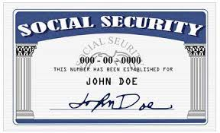

Social Security Administration
To create your own social security account online and get your estimate, go to:
  https://www.ssa.gov/myaccount/

Slide 104
Social Security Administration
Can start receiving partial benefits as early as age 62.
Full benefits at Full Retirement Age (FRA).
If you start receiving early, your benefits will be reduced by a small percentage for each month before your FRA, depending on your year of birth.
Example – if you were born 1960 or later and retire at 62 your benefit would be 30% lower than if you waited until your FRA of 67.
Notes:
Reminder: Full Retirement Age (FRA) under Social Security should not be confused with FERS Minimum Retirement Age (MRA)

Slide 105
Social Security Administration
FRA depends on your year of birth
Age | Year of birth
66 | 1943 – 1954
66 and 2 months | 1955
66 and 4 months | 1956
66 and 6 months | 1957
66 and 8 months | 1958
66 and 10 months | 1959
67 | 1960 and after

Slide 106
Social Security Administration
Working beyond your FRA
  Each extra year of work adds another year of earnings to your Social Security record.
  Your benefit will increase until you start receiving your benefits or until you reach age 70. The percentage varies depending on your year of birth.
  For example, if you were born in 1943 or later, you’ll add 8 percent to your benefit for each year you delay signing up for Social Security beyond your full retirement age.

Slide 107
Social Security Administration
Earnings limit – You can continue to work and still get retirement benefits. Social Security will reduce your benefits if your earnings exceed certain limits before you reach full retirement age:
  The years before your FRA – SSA will deduct $1 in benefits for each $2 you earn above the annual limit ($24,480 for 2026).
Notes:
https://www.ssa.gov/news/press/factsheets/colafacts2025.pdf

Slide 108
Social Security Administration
Earnings limit
  In the calendar year you reach your FRA – SSA will reduce your benefits $1 for every $3 you earn over an annual limit ($65,160 for 2026) until the month you reach FRA.
  Once you reach FRA there is no earnings limitation.

Slide 109
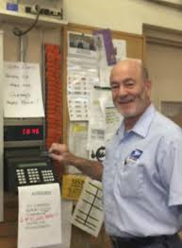
Joining the ‘Last Punch Bunch’
Decide what day to retire
Request annuity estimate & application
Other considerations & prep
Retirement counseling
Complete the forms
Send them in
Notes:
Here is what we are about to cover

Slide 110
Best day to retire
Once you are eligible to retire, you have the absolute right to decide when to retire. There may be financial considerations:
  Entitlement to FERS annuity begins the first day of the month following the month in which you retire. Therefore, many letter carriers decide to retire the last day of a month.
  Annual leave and sick leave are not credited if an employee does not remain employed for an entire pay period, so some decide to retire last day of a pay period to receive the leave.
  Big picture: any day that ends in ‘Y’ is a good day to retire.
Notes:
CSRS can retire on the 1st, 2nd, or 3rd day of the month and begin entitlement. Otherwise entitlement starts at the beginning of the next month like FERS.
OPM computes years of service for determining amount of annuity in years and months. Days over a month are dropped. So some LCs decide to retire on a date that results in the total years of service computing to exact years and months, with no (or few) extra days.
Annual leave and sick leave are credited each pay period. But if an employee does not remain employed for an entire pay period, no AL or SL is credited. Neither AL nor SL is prorated for working part of a pay period. So some LCs decide to retire on the last day of a pay period.
The amount of the Special Annuity Supplement is computed based on years of service under FERS (not including military time, prior non-career federal service, saved sick leave, etc.) rounded to the nearest whole number. So some FERS retirees decide to retire on a date that results in years of FERS service being just over 6 months instead of just under six months.

Slide 111

Get your annuity estimate
Call USPS Shared Services at 877-477-3273 and ask for annuity estimate based on desired retirement date.
Online at USPS LiteBlue for a quicker estimate.
Estimates do not oblige you to retire.

Slide 112
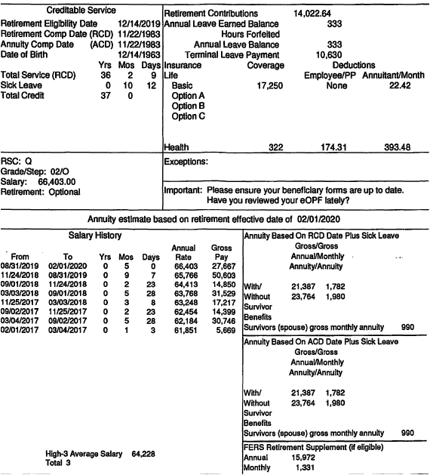
Annuity Estimate
Notes:
This is what a mailed annuity estimate looks like. Next slides discusses what it contains.

Slide 113
Military Deposit
Deposit for military time, unlike deposit for prior non-career federal service, must be completed prior to retirement.

Slide 114
Uniforms
Payment to the vendor is not allowed if the following conditions exist:
  The employee separates from the uniform program for any reason, including retirement, within 30 days following purchase of items of uniform wear that are not recognizable as distinctive uniform items unless worn with the basic outer garments of the uniform.
    Nondistinctive items: shoes, gloves, rubbers, galoshes, overboots, hose, face masks, pith helmets, and belts.
  When there is evidence that, before making the purchase, the employee indicated an intention to separate from the uniform program for any reason, including retirement…
See ELM Section 936.2

Slide 115
Official Personnel Folder
Official Personnel Folders (OPFs) contain important documents such as:
  Health and life insurance enrollments
  Designations of Beneficiary
  Form 50 history
Before you retire, save your eOPF. You will lose access immediately upon separation. You will not be able to retrieve documents from USPS after separation.
Problems can arise with retirement that can be resolved easily if the retiree has these documents.

Slide 116
Annuity Estimate
Check what retirement date the estimate is based on
Retirement Comp Date (RCD) is used to determine eligibility to retire and assumes all service listed on the service history report is accurate
Total Time = Total Actual Service plus Sick Leave
  Used to determine annuity computation
Contains High-3 Average Salary
Includes estimates with and without a survivor annuity benefit
Includes special annuity supplement estimate
Notes:
The Retirement Computation Date (RCD) is used to determine eligibility for retirement. The RCD assumes all service listed on the attached Service History Report - career, non-career, military, USPS or other Federal Agency – is accurate. The Annuity Computation Date (ACD) reflects service for which FERS contributions are funded and therefore creditable for the computation of your annuity. The ACD does not include service for which FERS contributions were not made, or were made and refunded to you, but you did not complete a redeposit.

Slide 117
Online Retirement Application (ORA)
The ORA system has been introduced rapidly and with minimal training. The NALC Retirement Department will be updating this presentation as we learn to navigate ORA. Member feedback is welcomed, as it will help us to better help others in the future.
Visit https://retire.opm.gov/help for an overview.

Slide 118

Watch the ORA User Guide, 8 ½ min.
Notes:
https://www.youtube.com/watch?v=LyABGO5cVg8

Slide 119
Online Retirement Application (ORA)
Call HRSSC at 877-477-3273 menu option 5 to start the retirement process. Your HR specialist creates your account using your personal email address. You will receive an email that your account is created. You will need a Login.gov account associated with your personal email
Once the HR specialist has prepared your application, you will receive an email from DoNotReply@retire.opm.gov to log in and begin your retirement application
When you log in, you will see that much of your information has been pre-populated. You will also see your annuity estimate on the right side of the screen
Notes:
https://retire.opm.gov/help

Slide 120
Online Retirement Application (ORA)
Review the prefilled information carefully. If you don't want to make any changes, you can make your elections and certify the application to your HR Specialist
If you'd like to make any changes to your information, you will need to submit the application for HR review. HR will update your service history, and then you will be able to review again and certify the application. If you get stuck and can’t proceed, uncheck the problem Box, complete & submit. In the "finalize" tab (last button, left column) there is a comment section. State what the issue was.

Slide 121
Online Retirement Application (ORA)
This system uses Login.gov, the U.S. Government's secure login tool. Visit www.Login.gov and sign in or create an account. Please sign in with your personal email and not your .gov or .mil email.
For more information visit https://retire.opm.gov/help and see the Login.gov linking guide.
You can submit a support ticket at the bottom of the latter webpage, but only for technical issues.

Slide 122
Certified Summary of Federal Service
Review your service history given on the application for accuracy. The heading should read Certified Summary of Federal Service. If you see anything amiss, follow the ORA instructions:
“ If you'd like to make any changes to your information, you will need to submit the application for HR review. HR will update your service history, and then you will be able to review again and certify the application”
Notes:
Postal Record Contract Talk, Retirement Processing Issues (June 2018): https://www.nalc.org/news/the-postal-record/2018/june-2018/document/ct.pdf

Slide 123

Submit the Application
If you don't want to make any changes, you make your elections and certify the application to your HR Specialist. At any point you can modify your existing application. If the application is certified to HR, you will need to re-certify following any edits you make.
Once your HR Specialist certifies your application package, it goes to payroll, who reviews it & transmits it to OPM.

Slide 124
Application Submitted
Once your application is submitted to OPM, (on your retirement date) you can no longer make changes in the ORA system. Please contact OPM Retirement Services.
You’ll receive a claim (CSA) number and one-time passcode from OPM. Then use OPM's Retirement Services Online to change your information & manage your annuity. You will use Login.gov to log in to Retirement Services Online.

Slide 125
Retirement Counseling
Call USPS HRSSC and request a counseling session.
Session is on the clock if scheduled during tour of employee.
You have a right to have your spouse and/or advisor present at the session.
  If the spouse/advisor is also a postal employee, they do not have a right to be on the clock.
You have a right to a private space for the session.
M-01708 in NALC’s Materials Reference System.
Notes:
http://mseries.nalc.org/M01708.pdf
Retirement Counseling ELM 589 https://about.usps.com/manuals/elm/html/elmc5_064.htm (CSRS provisions are found in Section 569)

Slide 126
Interim Payments
While OPM processes your application and calculates your benefit, they will begin making interim payments
  Computed at about 80% of estimated net annuity
  Only federal income taxes are withheld
  OPM makes annuity payments the first business day of the month. The payment is for the preceding month.
OPM will finalize your retirement
  Typically takes 2-3 months
  Begin paying your exact benefit with appropriate deductions
  Will account for any back pay due to the interim payments
Notes:
Advise that retirees should have some money set aside when retiring incase their interim payments are insufficient to cover their expenses (or don’t start in a timely manner).

Slide 127

Post-Retirement
Terminal Leave Payments
Direct Deposit of Annuity
Post-Retirement Debt Collection
OPM Services Online
Cost of Living Adjustments
Federal Income Tax
Notice of Annuity Adjustment
NALC Membership
Notes:
These are topics that will be covered next

Slide 128
Terminal Leave Payments
Lump sum terminal leave payment includes:
  accumulated AL up to maximum carryover (normally 440 hours, but expanded to 520 hours into the 2026 leave year)
  unused donated leave
  holidays that fall within the terminal leave period (for FTRs and PTRs)
Leave in excess of the carryover will be forfeited
  Any part of the unused AL earned during the leave year of separation that is in excess of the carryover is granted prior to separation. AL would need to be requested. See ELM 512.732b
Notes:
M-02002 changes carry over limit 520 into leave year 2025
https://s3.amazonaws.com/mseries.nalc.org/02002.pdf

Slide 129
Direct Deposit
OPM requires direct deposit of monthly annuity
Deposit can be to an account at a financial institution such as a credit union or bank
Or deposit can be to a Direct Express Card
  Can be used to make purchases at stores or financial institutions that accept MasterCard. There are no fees for the deposit into the card each month, and no charge for using the card to make purchases.
  Go to www.GoDirect.gov for information about fees and the surcharge-free network.

Slide 130

Post-Retirement Debt Collection
If you receive notice from USPS after separation that you owe money, immediately contact your branch and your NBA office. Two ways to appeal:
  30-day time limit to appeal through the Debt Collection Act which requires USPS to provide appeal rights.
  Or file a grievance which must be received at Step B within 30 days from the date the retiree first learned, or may reasonably have been expected to have learned, of the Postal Service’s intent to collect the debt.
Notes:
This right was introduced with the 2016 – 2019 National Agreement.
It is found on page 217 of the 2019-2023 National Agreement.

Slide 131

Post-Retirement Debt Collection
If you do not timely appeal (or pay/make a payment plan), USPS will advise the U.S. Treasury, which will deduct the debt from your retirement, income tax, social security, etc., without any appeal rights. Treasury will add interest and penalties.

Slide 132

OPM Services Online
Sign up!
www.servicesonline.opm.gov/
You need your CSA number and a temporary password, so you can’t sign up until you receive those from OPM.

Slide 133
OPM Services Online
View/print 1099-R tax forms
Change federal and state income tax withholding
View/print annuity statement and verification of income
View/print a year-to-date summary of payments
View/print verification of life insurance (FEGLI)
Change mailing address
Change password
Notes:
Functions that can be performed on Services Online

Slide 134
OPM Services Online
View the status of case while in interim pay
Establish an allotment to an organization
Request duplicate annuity booklet
Set up a checking or savings allotment
Sign up for direct deposit of annuity payment
Update email address/opt-in to receive information electronically
View/print retirement services reference card (ID card)
Notes:
Functions that can be performed on Services Online

Slide 135

Federal Income Tax
Your annuity is subject to federal income tax. The total amount you contributed into the Civil Service Retirement and Disability Fund over your working career, however, is tax sheltered, since that amount has already been subject to federal income tax.
Form 1099-R used to detail distributions from pensions.
  Will be available by end of January each year. Mailed and on Services Online.
  Includes Gross and Taxable amount.

Slide 136
Notice of Annuity Adjustment
OPM mails a hardcopy once a year if there is a change
  e.g., COLA increase
Notice shows:
  Gross
  Deductions
  Net
Survivor annuity is not listed as a deduction
  The gross annuity is the amount after reduction for survivor annuity

Slide 137
Notice of Annuity Adjustment
Some deduction/addition codes used on the NOAA
Code | Deduction
04 | Union Dues
31 | Federal Tax
42 | Dental Insurance
45 | Letter Carrier Political Fund
46 | FEGLI Basic Life Insurance
67 | FERS Special Annuity Supplement

Slide 138

Maintaining NALC Membership
Article 2 Section 1(a):
  Membership in the NALC shall be… retirees… who were regular members of the NALC when they retired…
Article 2 Section 1(e):
  A Form 1189 (Dues Check-off Provision) must be signed by all retiring members within the NALC who wish to retain their membership in said organization. An annuitant who was a member in good standing at the time of retirement may also sign this form and have their membership reinstated.
Form 1189 must contain CSA number.
Notes:
Sept/Oct 2024 Postal Record p.50 Nicole Rhine’s article on constitutional change regarding retiree membership and other reminders https://www.nalc.org/news/the-postal-record/2024/september-october-2024/document/s-t-1.pdf

Slide 139

Maintaining NALC Membership
National Constitution Article 7(b):
A member who has retired from the Postal Service under the CSRS or FERS shall pay to the National Association $7 per annum…

Slide 140
Annual State Retiree Dues
State | Dues | State | Dues
Alabama | $4.00 | Florida | $5.10
Alaska | $0 | Georgia | $2.50
Arizona | $0 | Guam | $0
Arkansas | $0 | Hawaii | $0
California | $0.50 | Idaho | $0
Colorado | $0 | Illinois | $0
Connecticut | $0 | Indiana | $0
Delaware | $0 | Iowa | $0
D.C. | $5.00 | Kansas | $7.85
Notes:
In addition to the national dues for retirees, some states have the following dues. Some local’s also charge a small amount.
Membership costs for retirees are very small.
Dues as of 2025

Slide 141
Annual State Retiree Dues
State | Dues | State | Dues
Kentucky | $0 | Montana | $0
Louisiana | $0 | Nebraska | $4.80
Maine | $0 | Nevada | $0
Maryland | $5.00 | New Hampshire | $0
Massachusetts | $1.25 | New Jersey | $1.00
Michigan | $0 | New Mexico | $0
Minnesota | $0 | New York | $6.25
Mississippi | $0 | North Carolina | $2.00
Missouri | $0 | North Dakota | $5.00
Notes:
Dues as of 2025

Slide 142
Annual State Retiree Dues
State | Dues | State | Dues
Ohio | $1.20 | Texas | $0
Oklahoma | $3.60 | Utah | $1.20
Oregon | $2.40 | Vermont | $0
Pennsylvania | $0.50 | Virginia | $6.00
Puerto Rico | $6.25 | Virgin Island | $0
Rhode Island | $0 | Washington | $7.20
South Carolina | $1.00 | West Virginia | $24.00
South Dakota | $0 | Wisconsin | $1.20
Tennessee | $2.00 | Wyoming | $0
Notes:
Dues as of 2025

Slide 143

Important Phone Numbers
USPS Shared Services: (877) 477-3273 option 5
NALC Retirement Dept: (202) 393-4695
  Toll-free (800) 424-5186
    Mon., Wed., Thur. 10-12 & 2-4 EST
National Business Agent:
Notes:
The QR code goes to nalc.org > regions so that participants can look up their NBA contact information.

Slide 144
Legislative Attacks on Retirement
2013 - FERS employee contributions increase from 0.8% to 3.1%
  FERS Revised Annuity Employees (FERS-RAE)
2014 - FERS employee contributions increase from 3.1% to 4.4%
  FERS Further Revised Annuity Employees (FERS-FRAE)
Many other attacks have been fought off
Notes:
Attacks on our retirement have come from both sides of the aisle. Letter carriers must stay engaged in politics to ensure we keep, and enhance, the benefits we derive through the law(s).

Slide 145
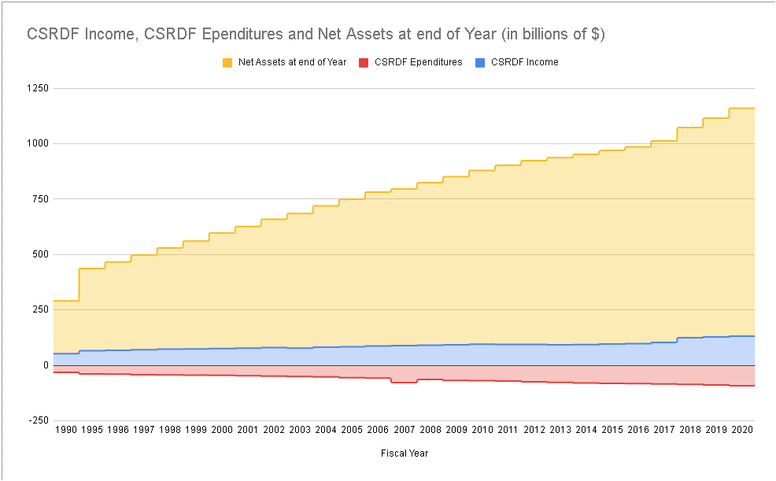
Notes:
Participants will not be able to read this chart. Explain what the colors are and that the graph goes from 1990 to 2020.
Point out that the Civil Service Disability and Retirement fund has always grown, and projections show that will continue. Why do we need to cut benefits or increase the costs to hardworking federal employees?
See also: A brief history CSRS and FERS https://www.nalc.org/news/the-postal-record/2020/october-2020/document/DRM.pdf
Civil Service Disability and Retirement Fund has always shown a pattern of growth while all those cuts were proposed and/or implemented:
Data Source: Pages 13/14 of https://crsreports.congress.gov/product/pdf/RL/98-972

Slide 146
Legislative Attacks on Retirement
2018, 2019, 2020 Budget Proposals to:
  change FERS employee contributions from 4.4% to 7.5%
  change high-3 to high-5
  eliminate FERS COLA
  reduce CSRS COLA
  eliminate FERS Special Annuity Supplement
  reduce TSP G-Fund interest rate
Notes:
https://www.vox.com/2019/3/12/18261739/trump-budget-2019-federal-workers

Slide 147

[FERS pension] remains much more generous, and other means might be considered in the future to move it even closer to private plans
“
”
Notes:
Project 2025 : https://static.project2025.org/2025_MandateForLeadership_FULL.pdf

Slide 148

Social Security Fairness Act
The Social Security Fairness act was signed into law Jan. 2025
Repealed the Windfall Elimination Provision (WEP) and Government Pension Offset (GPO)
  WEP/GPO unfairly reduced benefits for CSRS annuitants and their spouses
Notes:
118th Congress 2023-2024
NALC Fact Sheet: https://www.nalc.org/government-affairs/body/2023-WEP-and-GPO-fact-sheet-1.pdf
H.R. 82: https://www.congress.gov/bill/118th-congress/house-bill/82
S. 597: https://www.congress.gov/bill/118th-congress/senate-bill/597

Slide 149
Federal Retirement Fairness Act
H.R. 1522
Make a deposit or buy back non-career service after 1988, making it creditable service under FERS.
Would give the majority of our members an opportunity to buy back their service as casuals, transitional employees (TEs) and city carrier assistants (CCAs).
Notes:
https://www.congress.gov/bill/119th-congress/house-bill/1522
NALC Fact Sheets https://www.nalc.org/government-affairs/body/Fact-Sheets.pdf

Slide 150

Letter Carrier Political Fund
Fight Back!
Vote
Volunteer
Contribute
Note: By making a contribution to the Letter Carrier Political Fund, you are doing so voluntarily with the understanding that your contribution is not a condition of membership in the National Association of Letter Carriers or of employment by the Postal Service, nor is it part of union dues. You have a right to refuse to contribute without any reprisal. The Letter Carrier Political Fund will use the money it receives to contribute to candidates for federal office and undertake other political spending as permitted by law. Your selection shall remain in full force and effect until canceled. Contributions to the Letter Carrier Political Fund are not deductible for federal income tax purposes. Federal law prohibits the Letter Carrier Political Fund from soliciting contributions from individuals who are not NALC members, executive and administrative staff or their families. Any contribution received from such an individual will be refunded to that contributor. Federal law requires us to use our best efforts to collect and report the name, mailing address, occupation and name of employer of individuals whose contributions exceed $200 per calendar year. Any guideline amount is merely a suggestion, and an individual is free to contribute more or less than the guideline suggests and the union will not favor or disadvantage anyone by reason of the amount of their contribution or their decision not to contribute.

Slide 151
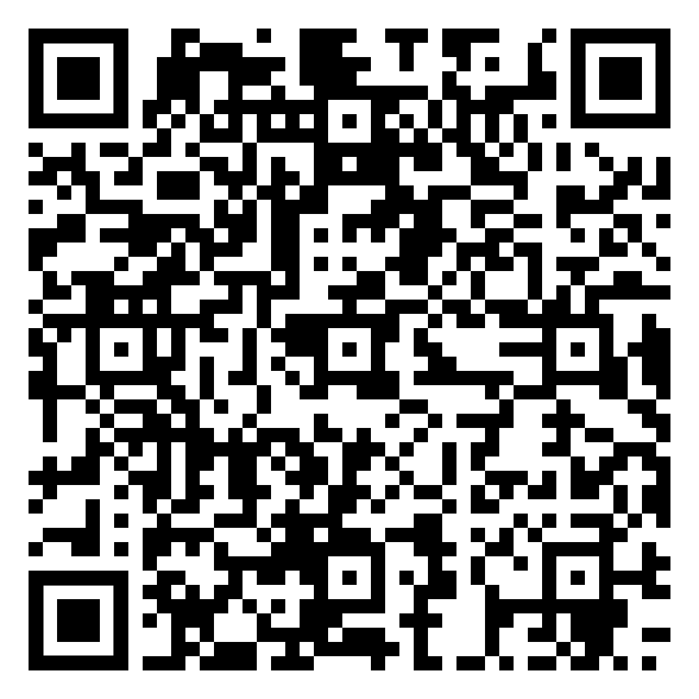
Letter Carrier Political Fund
Enroll by phone
  Call Brent Fjerestad (202) 393-4695
    Special Assistant to the President for Legislative & Political Organizing
Enroll online
  Log into OPM Services Online, click ALLOTMENTS TO ORGANIZATIONS, select Letter Carrier Political Fund
Enroll by mail – download the form in the QR code
Notes:
Annuitant sign up form: https://www.nalc.org/government-affairs/political-activity/body/letter-carrier-political-fund-postalease-annuity-2.pdf
Letter Carrier Political Fund https://www.nalc.org/government-affairs/political-activity/yes-i-want-to-become-a-pac-member
Brent Fjerestad will either take the call or forward to a Legislate and Political Organizer (LPO)

Slide 152

Need More Information?
NALC.org Workplace Issues Retirement
  Questions & Answers booklets
  Retirement columns
  COLA projections and updates
  Phone numbers
OPM.gov Retirement
  Questions and answers
  CSRS and FERS Handbook for Personnel and Payroll Offices
    The definitive rules and procedures to become a guru
Notes:
NALC Retirement https://www.nalc.org/workplace-issues/retirement
CSRS and FERS Handbooks https://www.opm.gov/retirement-center/publications-forms/csrsfers-handbook/

Slide 153

Questions and Answers
Notes:
Problems or ideas for this presentation? Feel free to contact the retirement department (202.393.4695) with suggestions.
Thank you to everyone that has contributed!

